Slide 1

Preoperative Fasting
Hannah Liu

Slide 2
Topic
For patients (adult/paediatric) undergoing anaesthesia for surgery, should they fast according to the current guideline or should “sip til send” be implemented, in order to minimise perioperative complications?

Slide 3
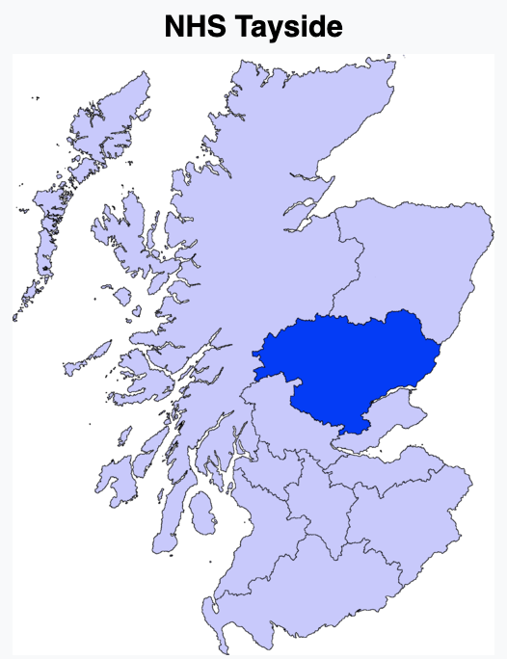

Sip Til Send
‘Fluid fasting in unscheduled patients in Ninewells Hospital’ (November 2020)
Mean fluid deprivation 7.5 hrs
Max 22 hrs
Repeated fasting over multiple days
Notes:
Fluid fasting audit in NHS Tayside

Slide 4
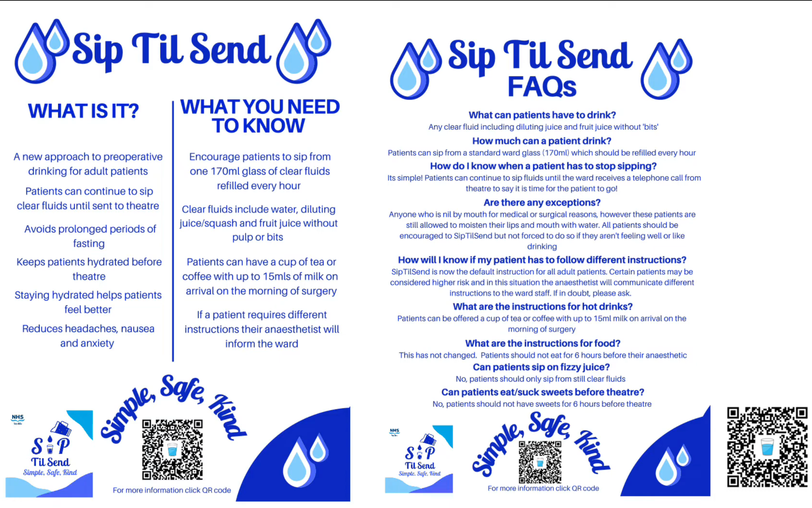
Notes:
Implemented in Dec 2021 after clinical governance approval
Exclusion
Patients with delayed gastric emptying (including diabetes/renal failure with gastroparesis)
Any relevant oesophageal pathology (e.g. severe GORD, hiatus hernia, achalasia, obstructing lesions, etc.)
Significant dementia or learning disabilities (or similar) where 30ml sip instructions may not be adhered to
Any surgical contraindications

Slide 5
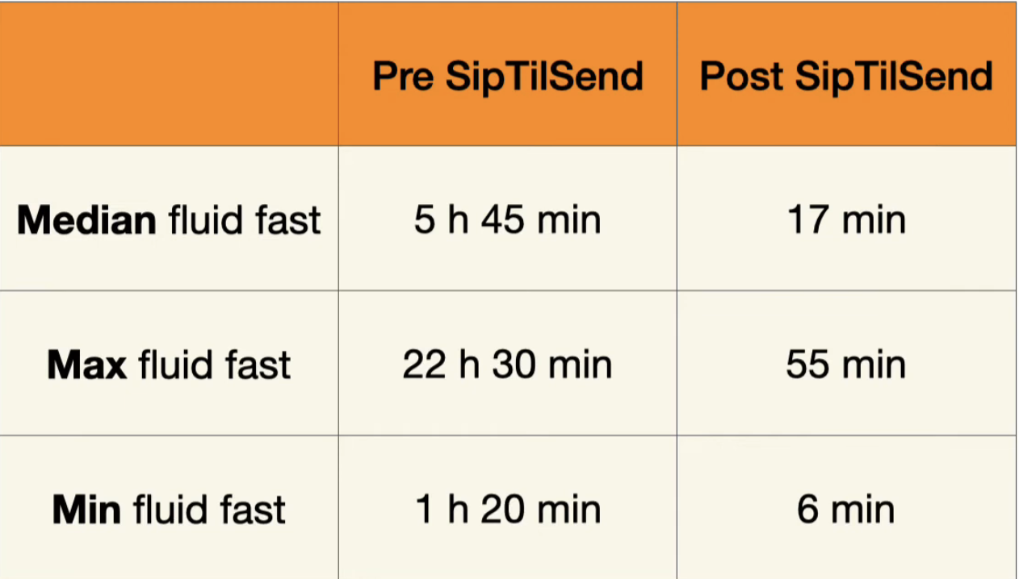
Notes:
Last drink till arrival at the anaesthetic room

Slide 6
Auburn preoperative fasting audit
A prospective clinical audit of patient solid and clear fluid fasting times for patients between February and March 2021
The median clear fluid fasting time was 7.8 hours (IQR 4.73-11.5 hours)

Slide 7
Adverse Events
Quarterly governance meeting + web-based Clinical Incident Management System
6 regurgitations in first 6 months
6/12000 cases = 0.05%
No sequelae - all DC same day
Ongoing monitoring
Notes:
Checketts MR. Fluid fasting before surgery: the ultimate example of medical sophistry? Anaesthesia. 2023 Feb;78(2):147-149. doi: 10.1111/anae.15925. Epub 2022 Dec 8. PMID: 36480436.
Has been rolled out to many hospitals in the UK, started in some hospitals in Australia - POWH, Sydney Children’s

Slide 8
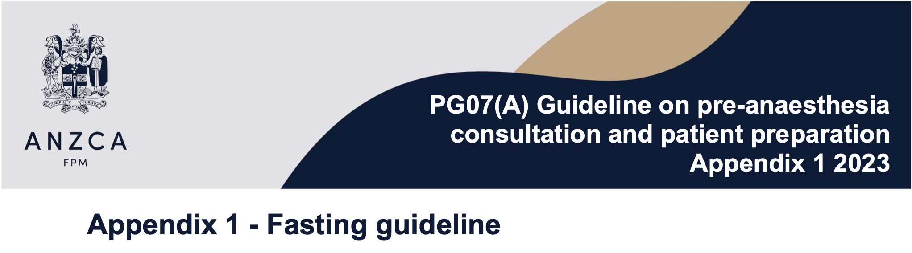
Current Preoperative Fasting Guideline
Notes:
management of ‘fasting’ in patients of all ages undergoing anaesthesia and is intended to include general anaesthesia, major regional anaesthesia, or any level of sedation exceeding minimal

Slide 9
Current Preoperative Fasting Guideline
For persons older than 16 years of age:
Solid food of a low calorific nature (light meal) may be allowed up to 6 hours prior to anaesthesia
Clear liquids - For elective and selected emergency procedures, clear liquids should be encouraged up to 2 hours prior to anaesthesia
For children up to 16 years of age:
Solid food is allowed up to 6 hours prior to anaesthesia
Prolonged fasting times should be avoided, and healthy children encouraged to drink clear liquids (water, pulp free juice, carbohydrate drinks) of 3 ml/kg/hr up to 1 hour before anaesthesia

Slide 10
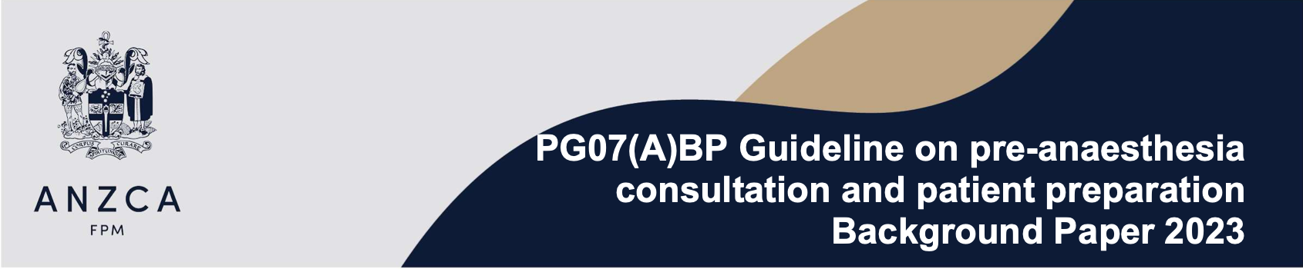
For example, currently there is interest in many international centres employing a ‘Sip Til Send’ or ‘Sip Til Leave Home’ protocol. There is also increasing use of point of care testing in the form of gastric ultrasound. While there appears to be increasing uptake of SipTilSend, which may be reasonable in a variety of settings, the thresholds have not been met for consensus statements to encourage routine reductions less than 2 hours for ingestion of clear liquids or routine reliance on point of care ultrasound. As volume of prospective data and reliability of evidence increases for a combination of practices, consideration will be given to applicability to this practice guideline.

Slide 11
Why do we fast?

Slide 12
Aspiration
Up to Date
Aspiration: 1 in 3000 ~ 7100
Significant morbidity: 1 in 7200 to 16,500
Mortality related to aspiration: 1 in 72,000 to 100,000 anesthetics
NAP4
The incidence of anaesthesia-associated fatal aspiration: 1 in 350 000
The most significant cause of airway-related mortality
  8 of the 16 (50%) anaesthetic deaths
  23 of the 133 (17%) reported primary anaesthesia events
Notes:
Although rare, aspiration is the most common reported cause of death under anaesthesia, and accounted for 23% of all cases reported as the ‘primary’ or ‘secondary’ major airway event
primary anaesthesia events: airway complications leading to death, brain damage, unanticipated ICU admission, or the need for an emergency surgical airway

Slide 13
Aspiration
The LOS is a physiological sphincter which is normally closed with a resting pressure of 15–25 mm Hg above gastric pressure (termed the barrier pressure)
↑Gastric volume → ↑Intra-gastric pressure
  There is little increase in intra-gastric pressure until gastric volume >1L
  Intragastric pressure is normally <7 mmHg
Mechanisms that increase aspiration risk:
  ↑Residual gastric volume (RGV)
  ↓pH
  ↓oesophageal sphincter tone
  Lost of airway protective reflexes
SURROGATE MARKERS
Notes:
Though gastric content values of volume and pH can only be considered surrogate measures of risk, more reliable measures are not (and may never be) available
Cochrane Review
For aspiration to occur, there needs to be sufficient volume in the stomach to be regurgitated, the protective function of the lower oesophageal sphincter needs to be overcome, and upper airway reflexes that close the glottis should be suppressed or absent. General anaesthesia blunts both lower oesophageal sphincter tone and upper airway reflexes, rendering anaesthetised patients susceptible to pulmonary aspiration.
The link between gastric volume and aspiration risk - in search of the Holy Grail?

Slide 14
Questions
What is the evidence for 2 hours clear fluid fasting?
What is the physiological transit time for clear fluid? What factors affect the transit time?
Is it safe to decrease fasting time for clear fluid?
  Does drinking clear fluid <2hr preop increase RGV?
  Does fasting reduce RGV?
  Does increased RGV correlate to increased risk of aspiration?
What are the adverse effects of prolonged fasting?

Slide 15
What is the evidence for 2 hours clear fluid fasting?

Slide 16
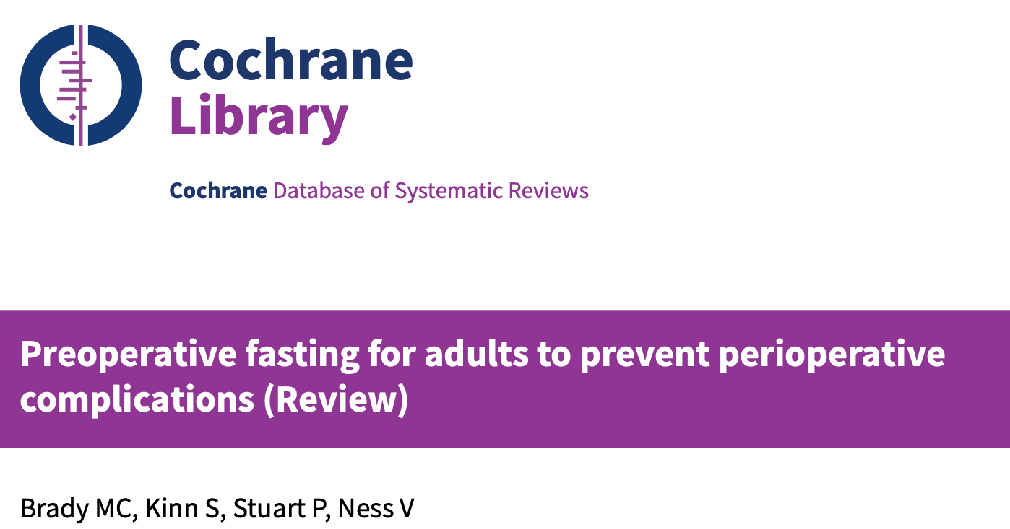
Notes:
Brady MC, Kinn S, Stuart P, Ness V. Preoperative fasting for adults to prevent perioperative complications. Cochrane Database of Systematic Reviews 2003, Issue 4. Art. No.: CD004423. DOI: 10.1002/14651858.CD004423.
Conducted at the time of NPO is the standard for both clear fluid and solid. Recent guidelines have recommended a shift in fasting policy from the standard 'nil by mouth from midnight' approach to more relaxed policies which permit a period of restricted fluid intake up to a few hours before surgery.
To systematically review the effect of different preoperative fasting regimens (duration, type and volume of permitted intake) on perioperative complications and patient wellbeing (including aspiration, regurgitation and related morbidity, thirst, hunger, pain, nausea, vomiting, anxiety) in different adult populations.

Slide 17
Cochrane Review on Preoperative Fasting
Primary outcomes
  Rates of adverse events (e.g. aspiration/regurgitation) or those following aspiration including related morbidity (e.g. aspiration pneumonia) or operation related death,
  Volume and/or pH of gastric contents (on induction of anaesthesia),
  Concentration of marker dye (e.g. Bromosulphthalein) as an indicator of gastric emptying.
Secondary outcomes
  Thirst
  Hunger
  Pain
  Nausea
  Vomiting
  Anxiety

Slide 18
Results
25 trials included
Inclusion Criteria: RCTs which compared the effect on postoperative complications of different preoperative fasting regimens on adults
Exclusion Criteria:
  Non random allocation of participants
  Observational study
  Non preoperative fasting focus
  co-interventions were not equal across groups
Most trials were based on healthy participants classified as ASA I-II
All trials (except Tanabe 1996) reported that participants were undergoing elective surgery.
All trials took measures to exclude gastric disease, disorders and/or drugs that affected gastric secretion or motility.
Three trials recruited participants considered to be at increased risk of regurgitation/aspiration during anaesthesia
  Obese (Body Mass Index > 30) (Maltby/Pytka)
  Women postpartum (1-5 days Lam 1993; 1-4 days Somwanshi 1995)
Notes:
In general the trials included within this review demonstrated a high methodological quality taking adequate steps to ensure the methods of random sequence generation were protected from bias and the assessors of gastric volume or pH had been blinded to whether participants were fasted or not.

Slide 19
Results
Aspiration/Regurgitation
None of these trials observed any aspiration/regurgitation and no trial measured the incidence of related morbidity or case fatality
Notes:
Only three trials that compared a shortened fluid fast to a standard fast reported the incidence of adverse events and associated morbidity (Gilbert 1995; Hausel 2001a; Hausel 2001b) and six recorded the incidence of regurgitation/ aspiration (Goodwin 1991; Phillips 1993; Søreide 1993a; Søreide 1993b, Hausel 2001a; Hausel 2001b).

Slide 20
Results - DURATION OF FAST
Gastric Contents - Volume
Fluid (up to 90 minutes preoperatively) v Overnight Fast
Fluid (between 120-180 minutes preoperatively) v Overnight Fast
  Fluid (120-180 minutes preoperatively) v Standard Fast (No H2- receptor antagonist)
No evidence of a difference between the two groups' gastric volume
Gastric Contents - pH
Fluid (up to 90 minutes preoperatively) v Overnight Fast
Fluid (between 120-180 minutes preoperatively) v Overnight Fast
  Fluid (120-180 minutes preoperatively) v Standard Fast (No H2-receptor antagonist)
No evidence of a difference in pH values between the groups
Notes:
Based on the timing of intake grouped into:
Intake permitted up to 90 minutes
120-180 minutes
Up to 180 minutes
There was however some indication of heterogeneity (p = 0.05). It was evident that mean gastric volume reported by some trials was considerably lower than the volumes reported by other trials. There was little difference between the type, volume and timing of the intake of preoperative fluid but two of the trials had administered an H2-receptor antagonist (ranitidine) co-intervention -> subgroup analysis
Fluid (up to 90 minutes preoperatively) v Standard Fast
The gastric volume of participants given one of two different amounts of water (150ml and 300-450mls) (total n = 50) was compared to the gastric volume of a standard fasting group (total n = 25) by two trials (Søreide 1993a; Søreide 1993b). On pooling the data there was no evidence of a difference in gastric content volume between the groups (WMD -8.00 mls CI 95%[-25.53, 9.53]).
Fluid (between 120-180 minutes preoperatively) v Standard Fast
20 trials compared the intake of fluids between 120-180 minutes preoperatively (n = 762) and a standard fasting regimen (n = 570). Pseudo-values for five trials were calculated (Maltby 1988; Phillips 1993; Samaan 1989a; Samaan 1989b) but are still awaited for one trial (Read 1991). There was no evidence of a difference between the two groups' gastric volume (WMD -0.84mls CI 95%[-2.77, 1.08]).
Fluid (120-180 minutes preoperatively) v Standard Fast (No H2- receptor antagonist)
Twelve trials compared a shortened fluid fast (fluids between 120-180 minutes preoperatively) to a standard fasting regimen. On pooling the trials there was little difference in the volume of gastric contents collected from the participants permitted a drink two to three hours preoperatively (n = 526) and those that fasted (n = 395) (WMD -2.05mls CI 95%[-5.59, 1.48]). The pseudo-values for Read 1991 are still outstanding and though the mean, median and range for the fluid (24.20, 21.00, 0-70mls) and fasted groups (25.70, 23.00, 0-115mls) is available, this data could not be fully presented within the meta-analysis.
Fluid (up to 90 minutes preoperatively) v Standard Fast
Søreide 1993a and Søreide 1993b evaluated the effectiveness of short fluid fast (water up to 90 minutes preoperatively n = 50) and standard fasting regimens (n = 25) in relation to participants' gastric pH. On pooling the results there was no evidence of a difference in pH values between the groups (WMD -0.19, CI 95% [-0.78, 0.40]).
Fluid (between 120-180 minutes preoperatively) v Standard Fast
Twenty trials evaluated the intake of fluid between 120 and 180 minutes preoperatively by comparing the gastric pH of participants following this shortened fluid fast (n = 633) and a standard fast (n = 499).
There was no evidence of a difference between the groups' gastric pH values (WMD 0.14, CI 95% [-0.04, 0.31]).
Fluid (120-180 minutes preoperatively) v Standard Fast (No H2-receptor antagonist)
Twelve trials
On pooling the results there was no evidence of a difference in the gastric pH of the participants permitted fluids 2~3 hrs pre-surgery (n=429) and those that continued to fast (n = 344) (WMD 0.16, CI 95% [-0.04, 0.35]).

Slide 21
Results - TYPE OF FLUID
Gastric Contents - Volume
Water v Overnight Fast (no H2-receptor antagonist)
  Nine trials: participants permitted a preoperative drink of water (n = 319) had a lower volume of gastric contents on induction of anaesthesia than those participants that followed a standard fasting regimen (n = 292).
  This difference was highly statistically significant (p = 0.00002, WMD -6.16 mls CI 95%[-9.41, -2.91]) but is not considered clinically significant.
Fruit Juice v Overnight Fast (no H2-receptor antagonist)
  No difference between the groups (WMD 0.50 mls, CI 95% [-6.50,7.50]
Other Fluids v Overnight Fast (no H2-receptor antagonist)
  No evidence of a between group difference in gastric volume (WMD 2.19 mls, CI 95% [-0.63, 5.00]).
Notes:
Water v Standard Fast (no H2-receptor antagonist)
As detailed above, the Samaan 1989a data presented within the meta-analysis is based on pseudo-values while similar calculations are awaited for the Read 1991 data.
Nine trials examined whether participants permitted a preoperative drink of water (n = 319) had a lower volume of gastric contents on induction of anaesthesia than those participants that followed a standard fasting regimen (n = 292). This difference was highly statistically significant (p = 0.00002, WMD -6.16 mls CI 95%[-9.41, -2.91]) but is not considered clinically significant.
Fruit Juice v Standard Fast (no H2-receptor antagonist)
Participants' gastric volume was measured to compare the preoperative intake of orange juice (n = 50) to a standard fast (n = 50) in one trial (Hutchinson 1988b), but there was no indication of a difference between the groups (WMD 0.50 mls, CI 95% [-6.50,7.50]).
Other Fluids v Standard Fast (no H2-receptor antagonist)
Four trials asked participants in the intervention groups (n = 233) to drink various other types of fluids during the preoperative period - a carbohydrate drink (Hausel 2001b), clear fluids (Splinter 1991; Phillips 1993) or offered participants the choice of water, fruit juice, coffee or tea (Maltby 1988). Control participants (n = 237) continued fasting. Pseudo-values were calculated for two trial data (Phillips 1993; Maltby 1988). On pooling the data there was no evidence of a between group difference in gastric volume (WMD 2.19 mls, CI 95% [-0.63, 5.00]).

Slide 22
Results - TYPE OF FLUID
Gastric Contents - pH
Water v Overnight Fast
Water v Overnight Fast (No H2-receptor antagonist)
Fruit Juice v Overnight Fast (no H2-receptor antagonist)
No difference between the groups' post induction gastric pH values
Notes:
Water v Standard Fast
Fourteen trials evaluated the preoperative intake of water (n = 381) to a standard fast (n = 361) by measuring the pH of the participants' intra-operative gastric contents. Pseudo-values were calculated for four trials' data (Samaan 1989a; Samaan 1989b; Samaan 1989c; Read 1991). Following pooling there was no evidence that gastric pH of participants that drank water preoperatively differed significantly from the pH levels of participants that fasted (WMD 0.09 CI 95% [-0.10, 0.29]). We explored the effect of H2-receptor antagonists on gastric pH in a sub group analysis.
Water v Standard Fast (No H2-receptor antagonist)
Nine trials randomly allocated participants to either the intake of water (n = 271) or a traditional fast (n = 246) and none included a H2-receptor antagonist co-intervention. There was no evidence of a between group difference in gastric pH values (WMD 0.07 CI 95% [-0.15, 0.28]). It is of note that the one trial (McGrady 1988) that found a significant difference between the groups' gastric pH also noted a significant difference between the mean weight of the randomised groups. While the methods of random sequence generation and concealment of allocation were considered adequate, the group permitted a preoperative drink were significantly heavier than the group that fasted.
Fruit Juice v Standard Fast (no H2-receptor antagonist)
Hutchinson 1988b compared the intake of orange juice (n = 46) and a standard fast (n = 49) and found no difference between the groups' post induction gastric pH values (WMD 0.00 CI 95% [-0.50, 0.50]).
Other Fluids v Standard Fast (no H2-receptor antagonist)
The preoperative intake of a carbohydrate drink (Hausel 2001b), clear fluids (Phillips 1993; Splinter 1991) or a choice of water, fruit juice, coffee or tea (Maltby 1988) was compared to a standard fasting regimen. Pseudo-values were calculated for two trials to allow presentation within the meta-analysis (Phillips 1993; Maltby 1988). Using a random effects model to pool the data, the intake of these various fluids resulted in significantly higher gastric pH values than the gastric pH of participants that followed a standard fast (WMD 0.21 CI 95%[0.00, 0.42]). Though the groups' pH values are significantly different (p = 0.04) the between group difference was marginal (0.2 of a pH) and not considered of clinical significance.

Slide 23
Results - SUBGROUPS OF 'AT-RISK' PATIENT POPULATIONS
Obesity
Obese participants (BMI > 30kg m2)
Standard preoperative fasting regimen (n = 65) VS intake of 300mls of clear fluid up to 180 minutes preoperatively (n = 65)
The fasting group mean gastric volume (29mls) VS the group permitted fluid (48mls) (p = 0.001, WMD 19 mls, CI 95% [7.47, 30.53]) - significantly lower
No evidence of a difference between the groups' intra-operative gastric pH
Postpartum
Postpartum participants were randomised to either receive 150mls of water (n = 70) or to follow a standard fast (n = 70) group.
There was no evidence of a difference between groups' intra-operative gastric content volume or pH
Notes:
Obesity
Participants who were obese (BMI > 30kg m2) were specifically recruited by Maltby/Pytka and randomly allocated to either a standard preoperative fasting regimen (n = 65) or a fasting regimen that included the intake of 300mls of clear fluid up to 180 minutes preoperatively (n = 65). The fasting group had a significantly lower mean gastric volume (29mls) than the group permitted fluid (48mls) (p = 0.001, WMD 19 mls, CI 95% [7.47, 30.53]).
Postpartum
Two trials were based on women one to four days (Somwanshi 1995) and five days postpartum (Lam 1993). Participants were randomised to either receive 150mls of water (n = 70) or to follow a standard fast (n = 70) group. Pseudo-mean and pseudo-standard deviation values were calculated for the Lam 1993 trial and pooled with the results from Somwanshi 1995 trial using a random effects model. There was no evidence of a difference between groups' intra-operative gastric content volume (WMD 1.37ml, CI 95% [-2.71, 5.44]).

Slide 24
Conclusion
There was no indication participants permitted fluids up to 90 minutes preoperatively were at increased risk (as measured by their gastric volume and pH) compared to participants that followed a standard fast.
Within this review there was clear evidence that intake of water during the preoperative period actually resulted in significantly lower volumes of gastric contents on induction of anaesthesia than had no fluids been taken. This difference however cannot be considered of clinical significance (6mls).
Obese participants (BMI > 30) permitted 300mls of clear fluids two hours preoperatively were noted to have a higher mean gastric volume than the fasted group that was statistically and clinically significant.

Slide 25
Pro
Comprehensive review
Compared
  Duration of fasting
  Fluid type
  At risk population group
Clinical significance considered
Limitations
Small sample sizes - no aspiration/regurgitation detected
Most participants were healthy, non-pregnant, adult population undergoing elective surgery
Lack of blinding
Notes:
Likely due to small sample size - n = 50~90 each group
Complete blinding of both participants and assessors as to the intake of food/fluid is difficult, if not impossible, to achieve

Slide 26
2 hrs?
In response to my inquiry, the chairman of the Canadian Anaesthetists’ Society’s Standards of Practice Committee informed me that he was unaware of clinical studies to support a 5-hr fasting guideline for clear liquids as well as solids. He encouraged us to pursue our proposed research so long as we left a ‘reasonable interval’ between ingestion of clear liquid and induction of anaesthesia.
- J Roger Maltby
Current adult guidelines only cite studies that investigated liquid fasting times between 2 and 4 h vs > 4 h or conclude that drinking up to 2 h before induction of anaesthesia has no effect on or even reduces gastric residual volume
Over a decade ago, the Scandinavian guidelines encourage 150 ml of water to be taken with a premedication up to 1 h before GA. There has been no increased incidence of adverse events
Notes:
Maltby JR. Fasting from midnight--the history behind the dogma. Best Pract Res Clin Anaesthesiol. 2006 Sep;20(3):363-78. doi: 10.1016/j.bpa.2006.02.001. PMID: 17080690.
Soreide E, Eriksson LI, Hirekar G, et al. Pre-operative fasting guidelines: an update. Acta Anaesthesiol Scand 2005; 49: 1041e7
Evidence free zone

Slide 27
What is the physiological transit time for clear fluid? What factors affect the transit time?

Slide 28
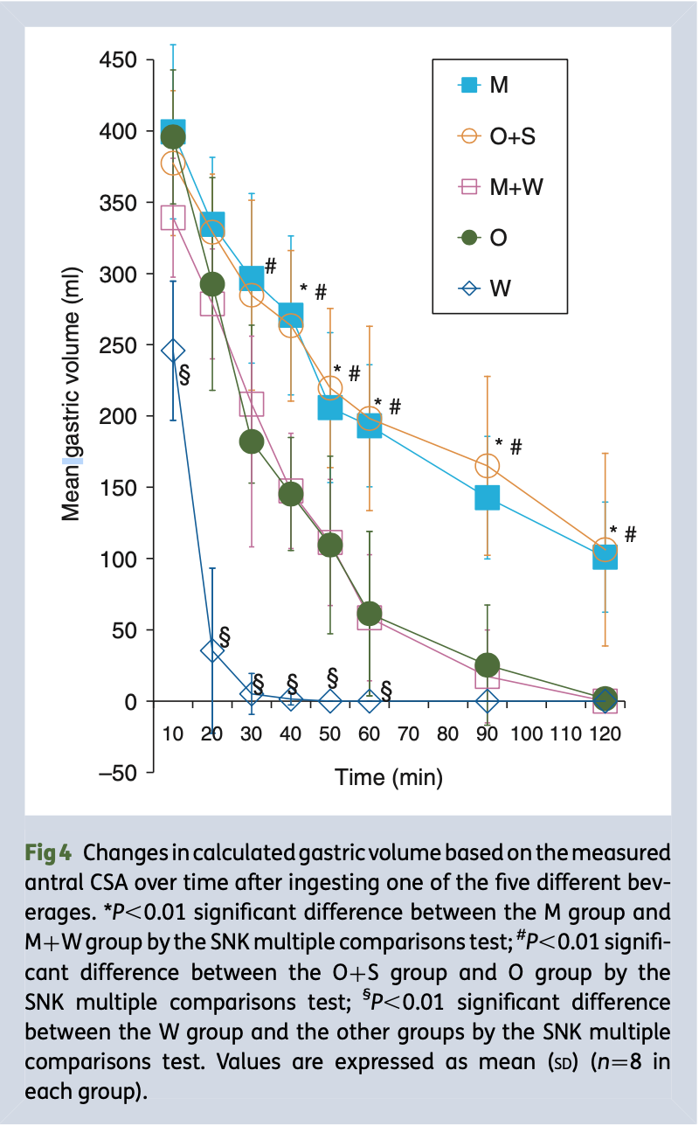
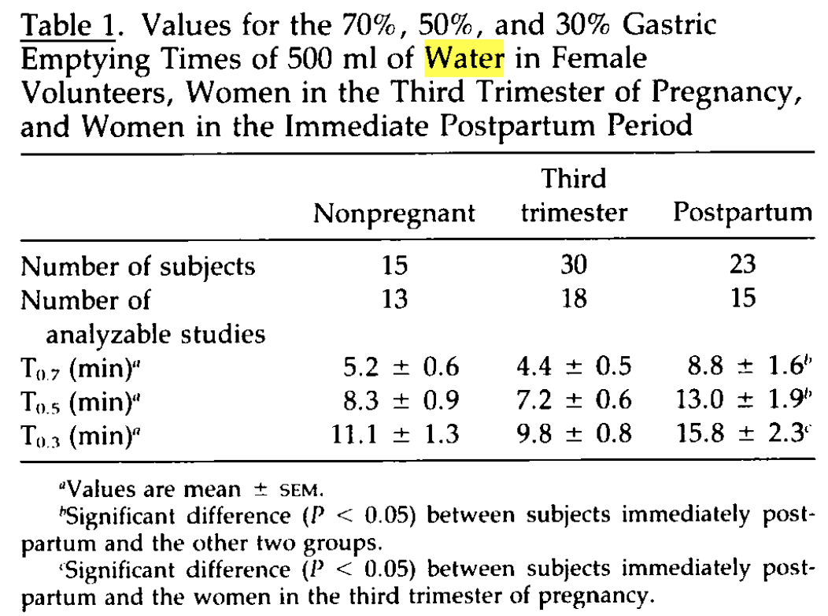
Notes:
Fig 4 from Determinants of liquid gastric emptying: comparisons between milk and isocalorically adjusted clear fluids
Previous studies have shown that 250–300 ml of water leaves the stomach in 30–60 min, and liquid gastric emptying is exponential
W group: 500 ml of water (0 kcal), O group: 500 ml of 100% orange juice (220 kcal), O+S group: 450 ml of 100% orange juice +50 ml of gum syrup (total: 330 kcal in 500 ml), M group: 500 ml of non-human milk (330 kcal), M+W group: 330 ml of non-human milk +170 ml of water (total: 220 kcal in 500 ml).
If the initial volume of liquid ingested is fixed, it is the energy content (total amount of calories) which is the critical determinant of liquid gastric emptying, regardless of compositional differences in the liquid; the energy content of the liquid ingested may be a primary determinant of the gastric emptying rate rather than the volume.
gastric emptying scintigraphy: The T1/2 exponential-fit clearance rate ranged from 7 to 19 min (12.4 +/- 3.1 min). For the mean plus 2 SDs, the upper range of normal T1/2 was 18.6, or less than 19 min; for the mean plus 3 SDs, the upper range of normal was 21.8 min, or less than 22 min
Ziessman HA, Chander A, Clarke JO, Ramos A, Wahl RL. The added diagnostic value of liquid gastric emptying compared with solid emptying alone. J Nucl Med. 2009 May;50(5):726-31. doi: 10.2967/jnumed.108.059790. Epub 2009 Apr 16. PMID: 19372480.
It takes about 5 half-lives for a drug to be roughly 97% eliminated (50% → 75% → 87.5% → 93.75% → 96.875%)
Table 1: T0.7, T0.5, and T0.3 are epigastric impedance had decreased to 70%, 50% and 30% of the maximum deflection
O’Sullivan GM, Sutton AJ, Thompson SA, Carrie LE, Bullingham RE. Noninvasive measurement of gastric emptying in obstetric patients. Anesth Analg 1987; 66: 505 – 11
What is the manner of gastric emptying after ingestion of liquids with differences in the volume under uniform glucose-based energy content?
The mean gastric volume decreased exponentially to nearly 0 ml 70 min after ingestion in the 200 ml group, 90 min in the 400 ml group, and 100 min in the 600 ml group. The volume of liquid ingested with a uniform glucose-based energy content is a critical determinant of liquid gastric emptying. The gastric emptying time may be predicted following the ingestion of an isocaloric liquid with any volume over a predefined range once a gastric emptying curve following the ingestion of a liquid has been plotted on a graph.

Slide 29
Is it safe to decrease fasting time for clear fluid?
Notes:
given the risk of aspiration is low (% 1 in 7000), any trial would require over 300,000 patients to detect a difference (with 90% power and p < 0.05), assuming that `Sip til Send ́ increases the incidence of aspiration by 10 times.
The effect of a `Sip til Send ́ policy on patient satisfaction: a quality improvement project

Slide 30
Paediatric preoperative fasting

Slide 31
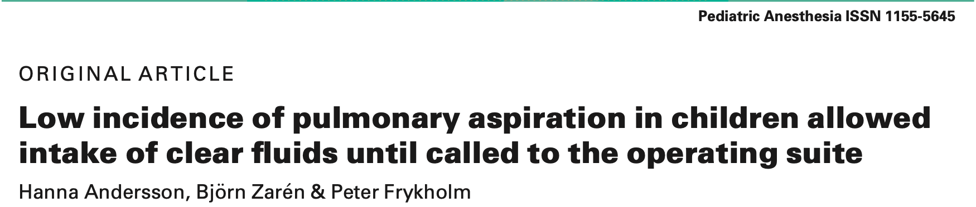
Aim: To determine the incidence of perioperative pulmonary aspiration in pediatric patients allowed unlimited intake of clear fluids prior to general anesthesia.
Results:
Of the 10 015 pediatric anesthetics included, aspiration occurred in three (0.03% or 3 in 10 000) cases. No case required cancellation of the surgical procedure, intensive care or ventilation support, and no deaths attributable to aspiration were found.
Pulmonary aspiration was suspected, but not confirmed by radiology or continuing symptoms, in an additional 14 cases.
Conclusion: Shortened fasting times may improve the perioperative experience for parents and children with a low risk of aspiration.
Notes:
Large scale, retrospective observational study looking at one paediatric anaesthesia unit in one hospital that has been implementing a liberal fasting regime (allowed to drink clear fluid until called to OT) for >a decade
Low incidence of pulmonary aspiration in children allowed intake of clear fluids until called to the operating suite
Liberalizing clear fluid intake has been demonstrated to have a similar risk of pulmonary aspiration
Andersson H, Hellstrom PM, Frykholm P. Introducing the 6-4-0 fasting regimen and the incidence of prolonged preoperative fasting in children. Pediatric Anesthesia 2018; 28: 46–52.
Method:
Elective pediatric procedures over 5yr period (January 2008 - December 2013)
Retrospectively examined by reviewing anesthesia charts and discharge notes in eMR.
All notes from the care event and available chest x-rays were examined for cases showing vomiting, regurgitation, and/or aspiration.
Exclusion criteria:
Neonates cared for in the NICU - follow other fasting regimes
Emergency surgery
Other procedures than surgery, e.g. radiation therapy or radiological examinations
ENT, Ophthalmology, or Neurosurgery - these departments still applied the 6-4-2 fasting routine and slightly different anesthesia methods

Slide 32
Pros
Large sample size - sufficient power to be able to detect increased risk of aspiration
Single centre - uniform anaesthetic methods
Clear definition for aspiration and suspected aspiration
Limitations
Single centre
Elective procedures only
Retrospective observational study without comparison group
Unclear actual fasting time
  Mean fasting time 1.7 h in small subgroup of preliminary survey
  Anaesthesia induction in our department usually occurs at least 30 min after the child is called to the operating room
Notes:
To detect an increase in incidence from 0.04% to 0.09%, with a 5% significance level and 80% power, a sample size of 9100 patients was required.
Pulmonary aspiration: children vomiting during anesthesia with observations of gastric contents in the airway and/or showing radiological findings consistent with aspiration and/or symptoms of respiratory distress (i.e., reduced saturation, increased respiratory rate, coughing, or wheezing) after surgery.
Suspected pulmonary aspiration: children vomiting during anesthesia and showing transient respiratory symptoms such as desaturation or signs as crackles, rales, or obstructive breathing, but WITHOUT symptoms of respiratory distress (i.e., reduced saturation, increased respiratory rate, coughing, or wheezing), or x-ray findings after surgery.

Slide 33
Adult preoperative fasting

Slide 34
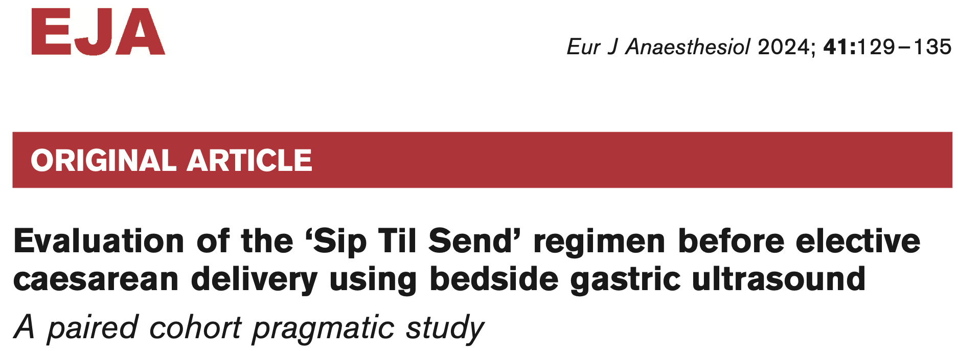
Notes:
Harnett C, Connors J, Kelly S, Tan T, Howle R. Evaluation of the 'Sip Til Send' regimen before elective caesarean delivery using bedside gastric ultrasound: A paired cohort pragmatic study. Eur J Anaesthesiol. 2024 Feb 1;41(2):129-135. doi: 10.1097/EJA.0000000000001926. Epub 2023 Nov 20. PMID: 37982593.
OBJECTIVES To compare residual gastric volumes in fully fasted non-labouring parturients before elective caesarean delivery with the ‘Sip Til Send’ with water liberal drinking protocol. Our hypothesis was the ‘Sip Til Send’ would be noninferior to standard fasting at minimising the residual gastric volume immediately before surgery.
DESIGN A paired cohort prospective observational pragmatic study using gastric ultrasound, analysed by an operator blinded to the fasting status of each scan.
SETTING A tertiary maternity hospital in Dublin, Ireland. The study was conducted between January and June 2023.
PARTICIPANTS Pregnant women about to undergo elective caesarean delivery who had followed ESAIC fasting guidelines before admission.
INTERVENTIONS
Each participant underwent two pairs (semi-recumbent and the semi-recumbent right lateral positions) of standardised ultrasound examinations of the gastric antrum. The first pair of scans occurred on admission before the ‘Sip Til Send’ protocol commenced, the other pair just before spinal anaesthesia for caesarean delivery, after a variable time following the ‘Sip Til Send’ protocol

Slide 35
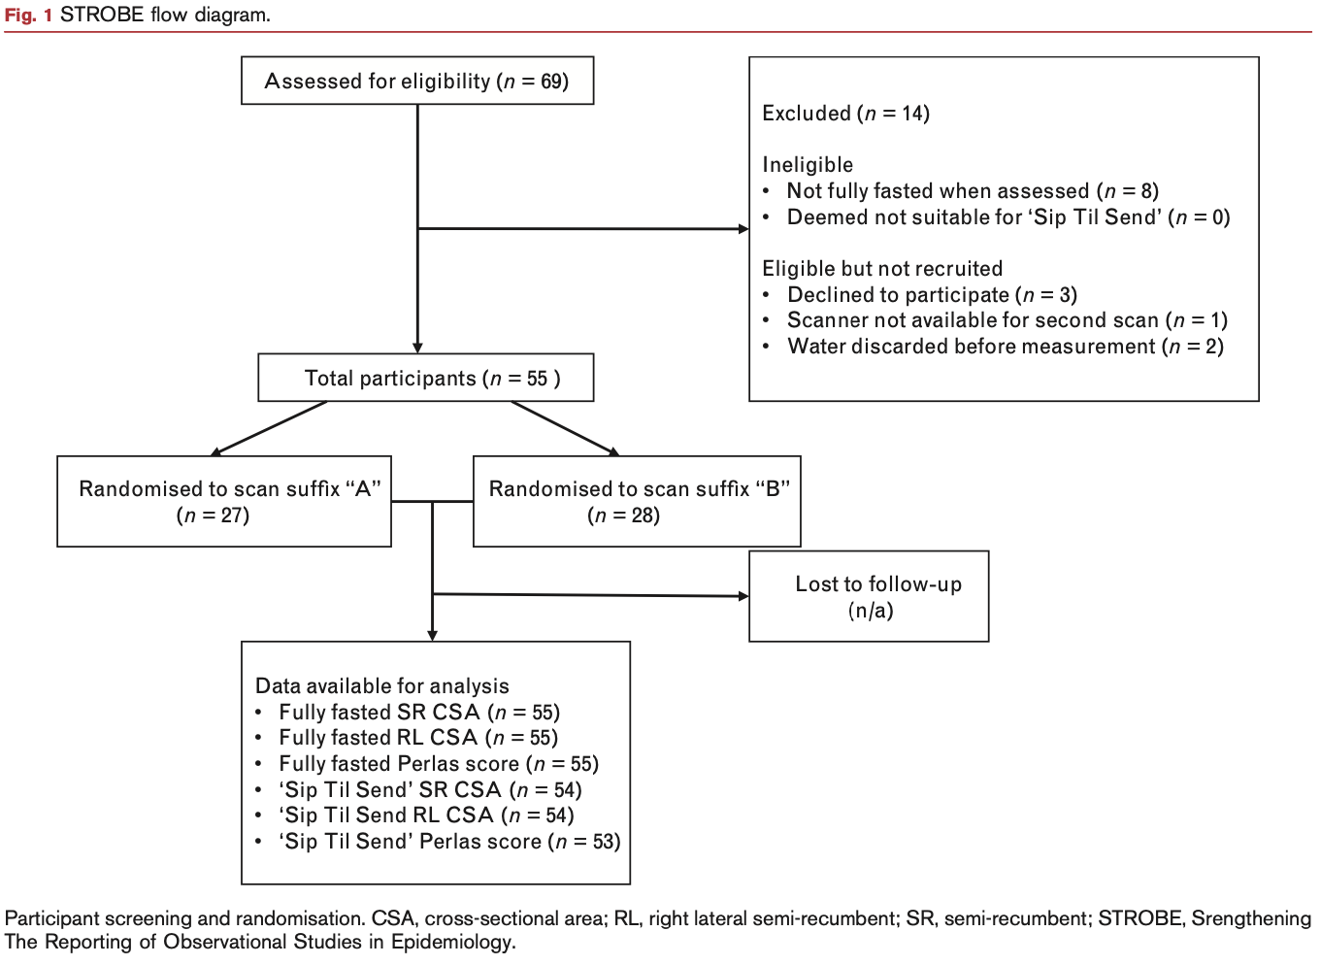
Notes:
The exclusion criteria were documented ineligibility for ‘Sip Til Send’, previous gastric or oesophageal surgery, patient refusal and inability to understand written English.
The sample size was calculated from the combined data of two previous studies from the same institution, yielding a mean right lateral antral CSA of 4.43 cm2 and standard deviation of 1.51 cm2. Using a 20% non-inferiority limit, which equated to 0.88cm2 and an estimated volume difference of 20 ml, 50 women were required to detect a difference with a significance of 0.05 and power of 0.9. Our aim was to recruit 55 women to allow for attrition.

Slide 36
MAIN OUTCOME MEASURE
Primary Outcome: the difference in antral CSA between the fully fasted women on admission and the same women after following the ‘Sip Til Send’ protocol until just before spinal anaesthesia.
Secondary Outcomes:
The estimated gastric volume using methodology validated in parturients
The incidence of estimated gastric volume >1.5 ml/kg using participants’ booking weights
The incidence of Perlas 2 grading
The correlations between the ‘Sip Til Send’ fasting time and estimated gastric volume
Notes:
The antral CSA on ultrasound demonstrates good linear correlation with gastric volume in parturients, making it an ideal surrogate measurement to use. Right lateral positioning is required to achieve the best results because antral CSA measured in the right-lateral semi- recumbent position correlates better with gastric volume than in the semi-recumbent position: however, linear regression modelling using both as covariates achieves the best correlation.
Mean baseline volume in a healthy fasted adult is about 0.5–0.8 ml/kg, with a 95%CI of 1.2–1.5 ml/kg
Ultrasound studies confirm that gastric volumes of up to 1.5 ml/kg are normal in healthy fasted individuals with baseline risk. This threshold corresponds to the 95–97th percentile of the healthy population
It is highly specific for ingestion of food or fluids since no more than 3–5% of fasted individuals will have a volume > 1.5 ml/kg. Even this threshold may be rather conservative; the true value of gastric volume that increases aspiration risk in humans is not currently known and might be higher.
Anaesthesia - 2017 - Van de Putte - The link between gastric volume and aspiration risk In search of the Holy Grail
Perlas grading indicates the qualitative presence of fluid in the antrum when assessed in supine and right lateral positions.15,16 Perlas 0 is assigned when no fluid is visualised in either position, Perlas 1 when fluid is visualised in the right lateral but not supine positions and Perlas 2 when fluid is visualised in both positions.

Slide 37
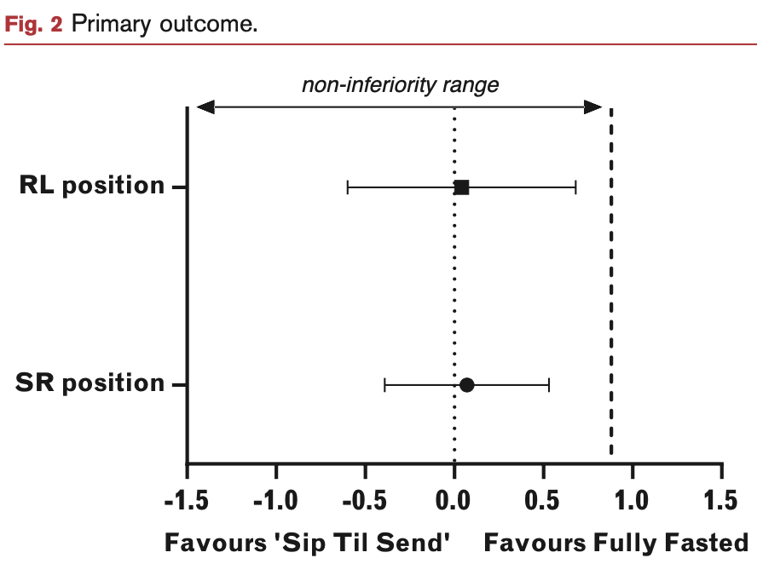
The mean differences (95% CI) in CSA in the
Semi-recumbent: 0.07 (-0.39 to 0.53) cm2
RL positions: 0.04 (-0.60 to 0.68) cm2
The of 95% CIs did not cross the predefined non-inferiority margin of 0.88cm2, ‘Sip Til Send’ was non-inferior to fully fasting in in terms of the antral CSA.

Slide 38
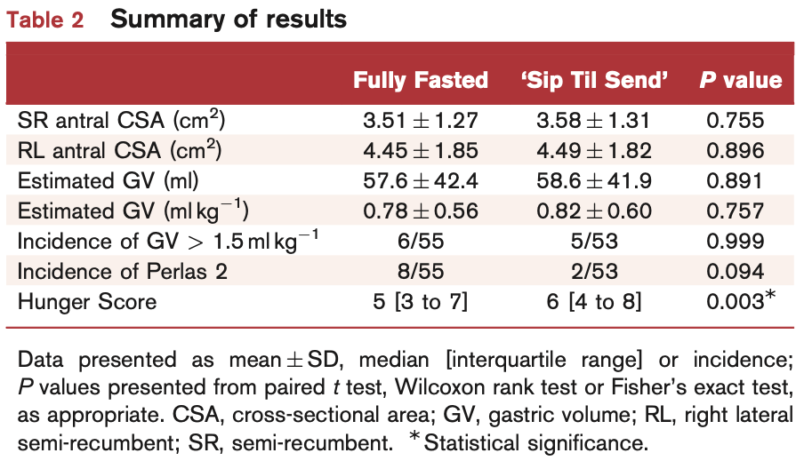
Notes:
no differences were observed between groups in the estimated gastric volume or the incidence of gastric volume >1.5 ml/kg.

Slide 39
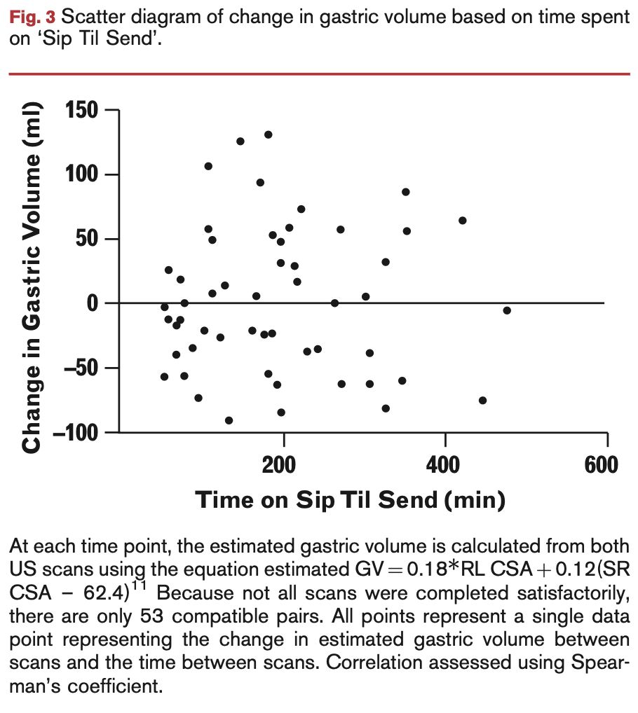
Notes:
There were no correlations identified between the time spent ‘Sip Til Send’ fasting and either the estimated gastric volume before surgery or the change in estimated gastric volume between scans (r = -0.068, P = 0.628; r = 0.027, P = 0.843; Fig. 3).

Slide 40
CONCLUSION
The ‘Sip Til Send’ protocol of liberal hydration with water was noninferior to standard fasting prior to elective caesarean delivery.

Slide 41
Pros
Baseline scan was obtained after guideline fasting and Sip Til Send
Acted as own control
Assessors are blinded
Minimum sample size calculated based on non-inferiority
Clinically useful outcomes
  Gastric volume in ml/kg
Correlation between between the time spent ‘Sip Til Send’ fasting and gastric volume
LIMITATIONS
Pragmatic design and lacked strict experimental conditions
The fully fasted group was based on participant self-reporting and had no maximum fasting period, which may be inaccurate or excessively heterogenous
The impact of one fasting method has on the other cannot be accounted for due to the paired nature of study design
No safety outcome data
Underpowered to detect a difference between groups
Neuraxial anaesthesia only
The mean ‘Sip Til Send’ fasting time was 3.3+/-1.8 h, with participants drinking a mean of 100.5+/-51.7 ml/h
Notes:
The paired nature of the study design means each participant acted as their own control; however, all participants underwent an overnight fast before initiation on ‘Sip Til Send’ and the impact of one fasting method has on the other cannot be accounted for without inclusion of a second group that undergo ‘Sip Til Send’ before fully fasting, which would not have been feasible.
No safety outcome data during the study such as nausea and vomiting due to the confounding aspects of the anaesthesia technique (e.g. use of ergometrine). No incidents of gastric aspiration occurred during the conduct of this study.

Slide 42
Increased RGV increases aspiration risk?
There was no evidence to support a linear relationship between RGV and pulmonary aspiration.
Notes:
Unrestricted drinking before surgery: an iterative quality improvement study
Cochrane Review

Slide 43
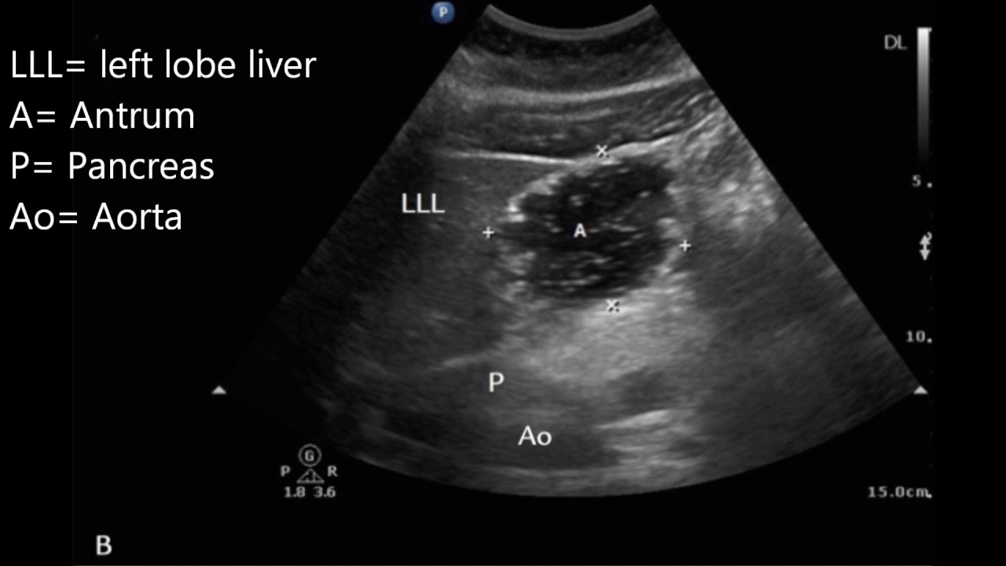

Fasting longer = lower RGV?
An ultrasound study of ASA physical status 1~3 patients presenting for elective anaesthesia apparently without risk factors for delayed gastric emptying showed that despite fasting, around 6% of patients had a significant volume of residual gastric fluid, and 1.7% had solid contents identified
Notes:
Van de Putte P, Vernieuwe L, Jerjir A, Verschueren L, Tacken M, Perlas A. When fasted is not empty: a retrospective cohort study of gastric content in fasted surgical patients. Br J Anaesth 2017; 118: 363e71

Slide 44
Prolonged Fasting
Fasting duration is often substantially longer than recommended irrespective of a 1- or 2-h clear liquid fasting policy
Prolonged fasting influences
  Patient-related outcomes: preoperative thirst, hunger, anxiety, nausea and vomiting, pain, and reduced feeling of well-being
  Clinical outcomes: dehydration, difficult cannulation, electrolyte imbalance, postoperative delirium, and hypotension at induction of general anesthesia
Notes:
ASA update

Slide 45
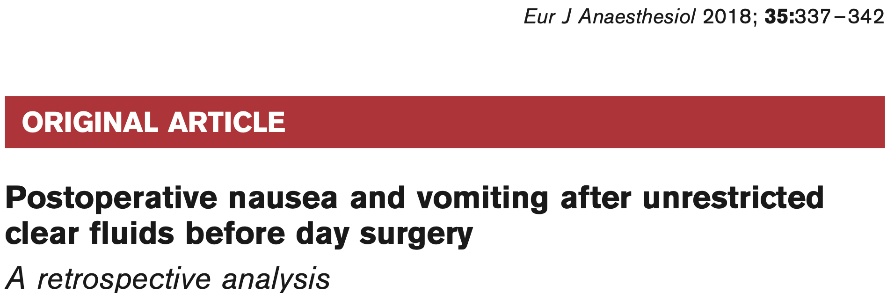
Notes:
McCracken GC, Montgomery J. Postoperative nausea and vomiting after unrestricted clear fluids before day surgery: A retrospective analysis. Eur J Anaesthesiol. 2018 May;35(5):337-342. doi: 10.1097/EJA.0000000000000760. PMID: 29232253.
BACKGROUND
One day surgery unit commenced an unrestricted fluid policy in October 2014, encouraging patients to drink clear fluids up until the time of transfer to theatre.
OBJECTIVE The aim of this study was to assess the incidence of PONV before and after the change to the unrestricted pre-operative clear oral fluids.
DESIGN Retrospective, before and after study.
SETTING Single district general hospital between November 2013 and February 2016 - This period included at least 12 months either side of the change in drinking policy.

Slide 46
PATIENTS
11500 patients on the day case pathway who were receiving either sedation, GA, regional or combination.
Exclusions: patients undergoing a termination of pregnancy, or patients undergoing community dental procedures, from whom patient experience data are not collected
INTERVENTION Introduction of a change to the day surgery pathway policy permitting unrestricted clear oral fluids pre-operatively until transfer to theatre (from October 2014).
MAIN OUTCOME MEASURES Incidence of postoperative nausea and vomiting.
Notes:
This number of patients represents approximately 78% of all patients before the change in fluids policy and 74% after the change.
Data collected: date of surgery, age, sex, American Society of Anesthesiologists (ASA) physical status, surgical specialty, anaesthetic type (including use of total intravenous or volatile anaesthesia, supraglottic airway or tracheal tube, spontaneous or intermittent positive pressure ventilation), surgical procedure(s), anaesthetic start time and time on entry to the postanaesthesia recovery ward. The duration of a procedure was timed from the start of anaesthesia until arrival in the recovery ward. Discharge or unexpected admission information is also collected for every patient.
Data not collected: BMI, smoking status, previous postoperative nausea and vomiting, nor susceptibility to motion sickness

Slide 47
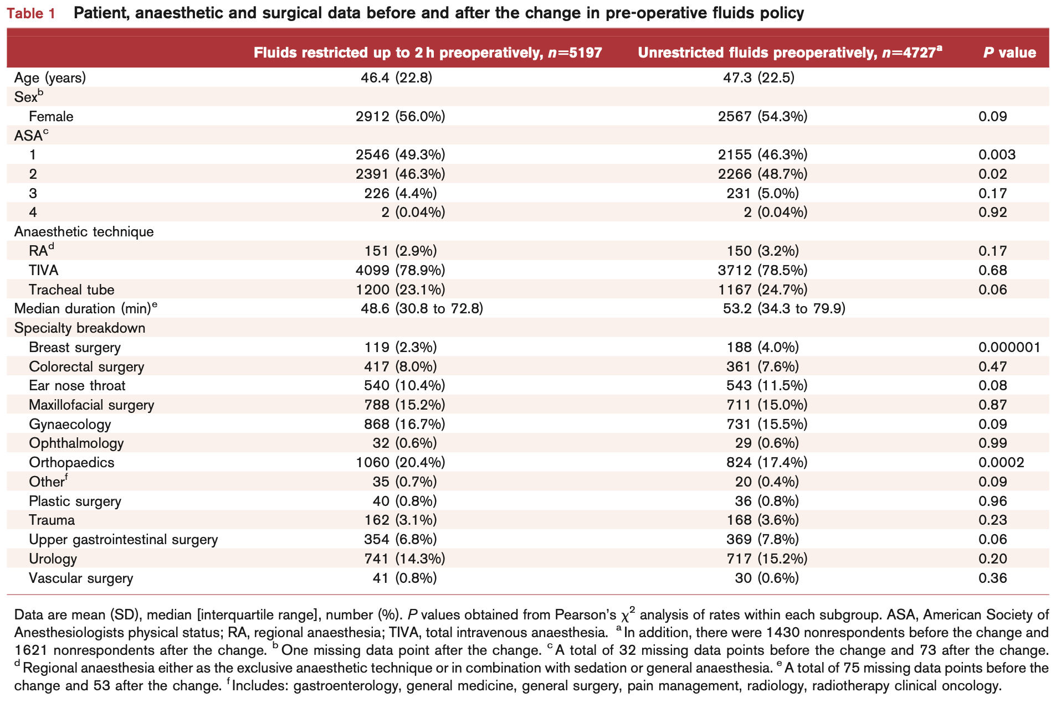
Notes:
Majority ASA1~2
Majority cases used TIVA
Good spread of different specialties

Slide 48
RESULTS
The corresponding rates of vomiting were 146/5186 (2.8%) and 104/4716 (2.2%), a relative rate (95% confidence interval) of 0.78 (0.61 to 1.00), P = 0.053.
Notes:
No significant difference in proportion of subgroups

Slide 49
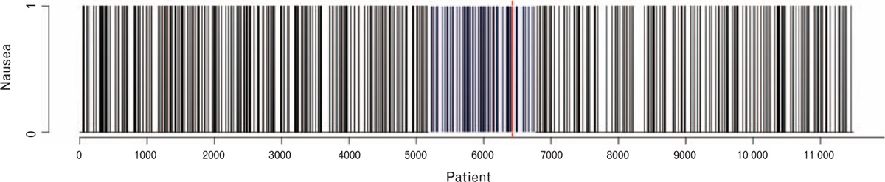
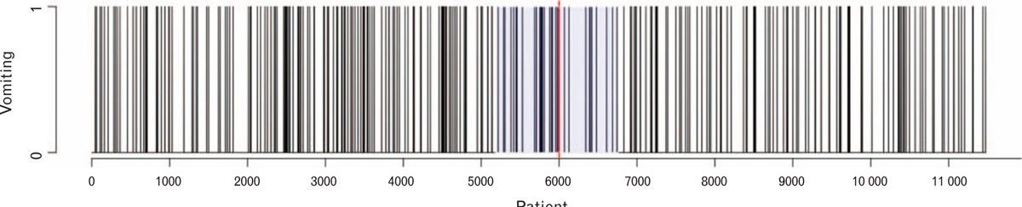
Notes:
Fig. 1
Continuous series of patients who were nauseated (black bar) or not (no bar). The change point is depicted by the vertical red line (patient 6429). The change in fluids policy crossover period is shaded blue.
Fig. 2
Continuous series of patients who vomited (black bar) or not (no bar). The change point is depicted by the vertical red line (patient 6000). The change in fluids policy crossover period is shaded blue.
We used the ‘cpt.meanvar’ function (Poisson distribution) ‘changepoint’ to determine whether there was a ‘point change’ or inflection in the rate of nausea or vomiting between November 2013 and February 2016 (including any crossover period)
A ‘changepoint’ reduction in nausea was centred on 5 February 2015 (Fig. 1) and a change- point reduction in vomiting centred on 7 January 2015 (Fig. 2), both of which were within our predefined crossover period.

Slide 50
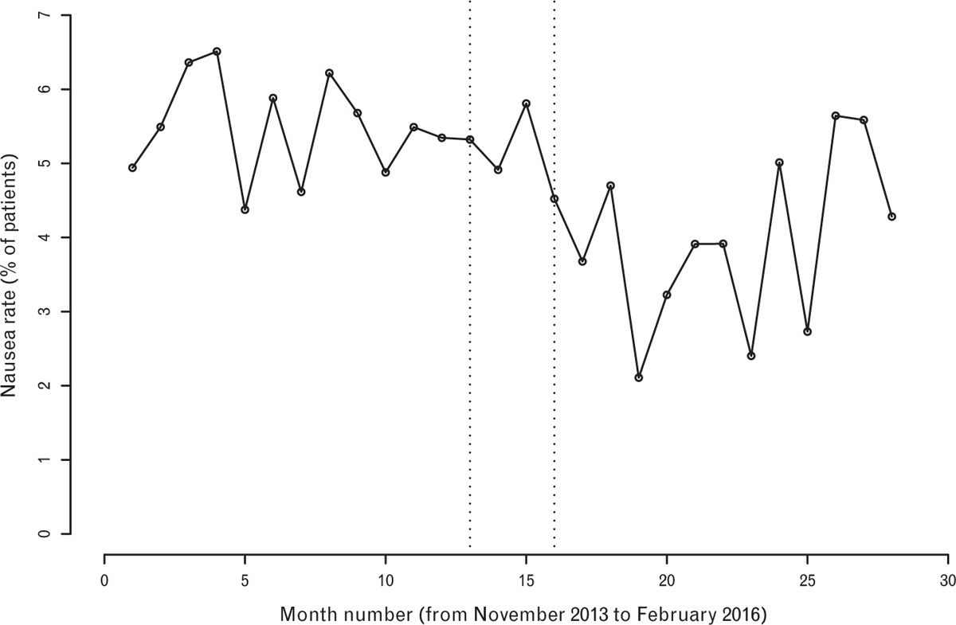
 | Standard | Liberal | RR (95% CI)
Postop nausea | 270/5192 (5.2%) | 179/4724 (3.8%) | 0.73 (0.61 ~ 0.88), P = 0.00074
Mod/severe nausea | 68/5192 (1.3%) | 31/4724 (0.7%) | 0.50 (0.33 ~ 0.76), P = 0.001
excluding patients who had neither sedation nor GA | 263/5088 (5.2%) | 175/4646 (3.8%) | P = 0.0009
Notes:
Fig. 3
Monthly incidence (percentage rate) of postoperative nausea in day surgery pathway patients (crossover period bordered by vertical dashed lines).
Fig. 4
Monthly incidence (percentage rate) of postoperative vomiting in day surgery pathway patients (crossover period bordered by vertical dashed lines).

Slide 51
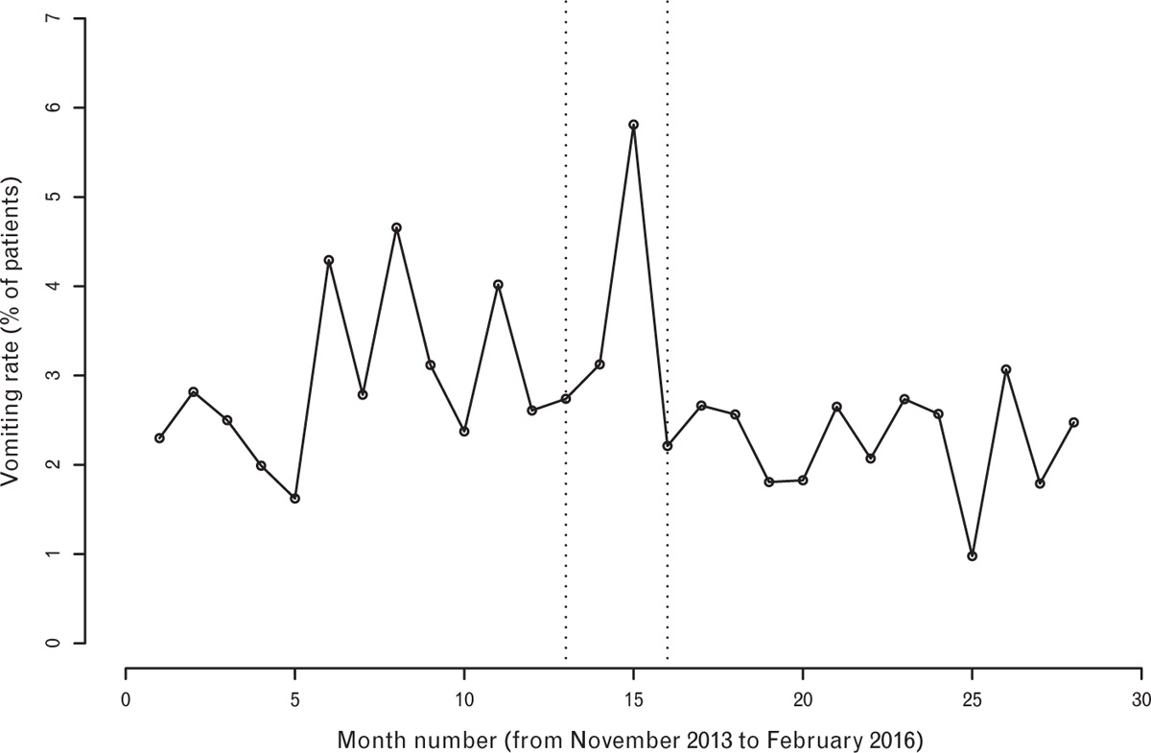
 | Standard | Liberal | RR (95% CI)
Postop vomiting | 146/5186 (2.8%) | 104/4716 (2.2%) | 0.78 (0.61 to 1.00), P = 0.053
excluding patients who had neither sedation nor GA | 143/5082 (2.8%) | 101/4638 (2.2%) | P = 0.045
Notes:
Multivariate regression analysis demonstrated a statistically significant reduction in both postoperative nausea and vomiting when fluids were unrestricted:
Nausea: adjusted odds ratio (OR) (95% CI) of 0.26 (0.11 to 0.60), P = 0.0016
Vomiting: adjusted OR of 0.52 (0.28 to 0.97), P = 0.039
There were no differences in rates of nausea and vomiting between the first and second 6 months of each 12 month period.

Slide 52
Patients Satisfaction
  ‘Very good’ after 2331/5188 (44.9%) operations when drinking was restricted VS after 2269/4697 (48.3%) operations when clear fluids were unrestricted
  Relative rate (95% CI) of 1.08 (1.03 to 1.12), P = 0.0008.
Notes:
to identify continuous trends in each outcome, independent of our change in fluids policy

Slide 53
There were no adverse events of pulmonary aspiration of gastric contents requiring patient admission
As of October 2017, total of 15 214 patients undergone GA or regional or sedation or combination on the day surgery pathway since the change in policy
  One aspiration event necessitating tracheal intubation and admission
Notes:
BMI 35, history of possible GORD

Slide 54
CONCLUSION
Our data suggest that the liberal consumption of clear fluids before the induction of scheduled day case anaesthesia reduced the rates of PONV

Slide 55
PRO:
Large sample size
Compared pre and post intervention
Demonstration of a change point at a distinct point in a continuous series of patients that coincided with the crossover period of our change in fluids policy
LIMITATIONS:
The volumes or timing of ingested fluids preop were not collected
No record of use of antiemetics
  Similar spend on antiemetic agents from our pharmacy department → the use of antiemetic agents consistent
No data on
  BMI
  Smoking status, patient history of previous PONV or motion sickness
  GI issues
>90% ASA1~2

Slide 56
Answer?
Current guideline is based on trials that fasted up to 2hrs for clear fluid, no evidence that <2hr clear fluid fasting will increase risk of aspiration
Clear fluids, esp. water, empty from stomach exponentially with t1/2 ~10mins
  The volume and caloric content of fluid ingested are the main factors affecting transit time
Is it safe to decrease fasting time for clear fluid? - PROBABLY
  Studies on gastric volume and pH showed no significant difference between “Sip Til Send” VS traditional clear fluid fasting in preoperative patients - lower quality studies in selected patient groups
  Has been implemented in multiple hospitals without significant increase in adverse events
  The rarity of pulmonary aspiration contributes to difficulty conducting clinical trials to directly address this, as numbers to sufficiently power them are prohibitively large
  Prolonged fasting ≠ empty stomach
Prolonged fasting can result in PONV, metabolic derangement, hypovolaemia, HD instability, thirst, anxiety, etc.
Notes:
Does lack of evidence for <2hr equals no risk?
Physiological evidence of fluid passing exponential but ?clinical evidence
At risk population
Does having RGV = increased risk of aspiration
Factors that change the normal physiology
Checketts MR. Fluid fasting before surgery: the ultimate example of medical sophistry? Anaesthesia. 2023 Feb;78(2):147-149. doi: 10.1111/anae.15925. Epub 2022 Dec 8. PMID: 36480436.

Slide 57
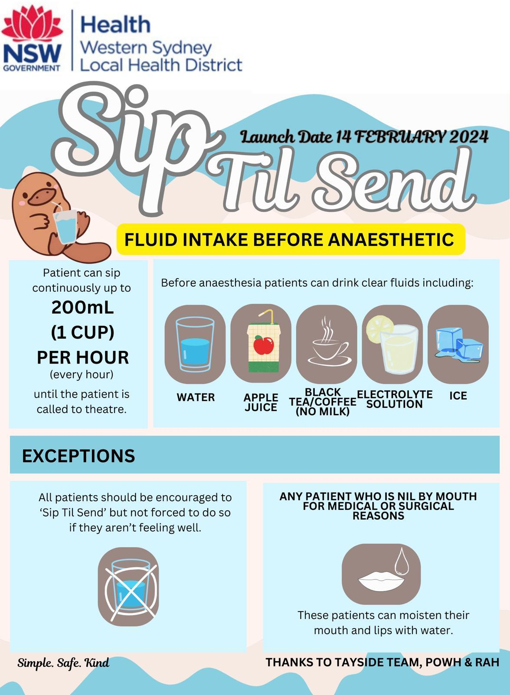
Notes:
Adult patients will be encouraged to sip on clear fluids at a rate of 200mLs per hour up until the time they are sent for theatre.
Children will be encouraged to sip on clear fluids at a rate of 3 mL/kg/hr (up to 60kg weight) up until the time they are sent for theatre.
Fasting times for solids will remain unchanged at 6 hours prior to procedure
Exclusion criteria for this policy will be determined based on surgical/patient/anaesthetic factors and clearly highlighted in the implantation policy. This will form part of the education process of the written guidelines.

Slide 58
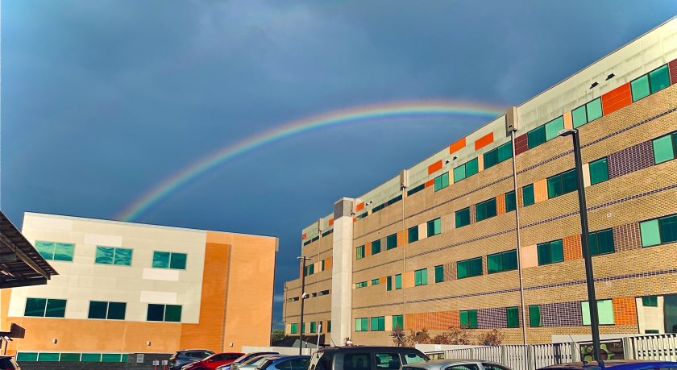
What does this mean for Auburn?

Slide 59
Sip Til Send at Auburn
Audit of current fasting time, send to induction time
Questionnaire for perioperative staff re Sip Til Send
Education
Preoperative Journey
  Identify at risk patients
  CLEAR INSTRUCTION
    Language barrier
    Fasting card
On the day of surgery
  CLEAR INSTRUCTION
  Monitor: writing on the cup when the water was poured
Notes:
Unrestricted drinking before surgery: an iterative quality improvement study - Ruggeberg et al

Slide 60
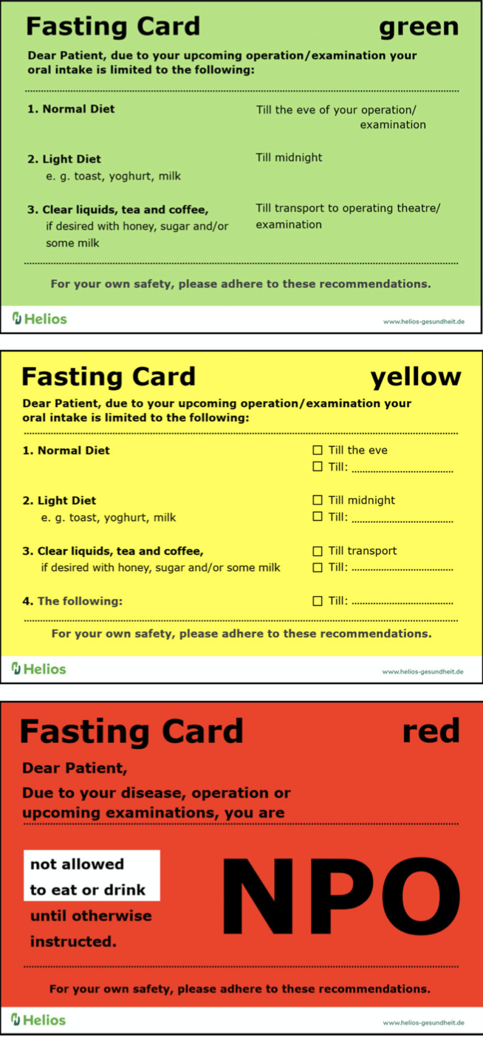

Slide 63
REFERENCE
Brady MC, Kinn S, Stuart P, Ness V. Preoperative fasting for adults to prevent perioperative complications. Cochrane Database of Systematic Reviews 2003, Issue 4. Art. No.: CD004423. DOI: 10.1002/14651858.CD004423.
Andersson H, Hellstrom PM, Frykholm P. Introducing the 6-4-0 fasting regimen and the incidence of prolonged preoperative fasting in children. Pediatric Anesthesia 2018; 28: 46–52.
Marsman M, Pouw N, Moons LMG, van Klei WA, Kappen TH. Gastric fluid volume in adults after implementation of a liberal fasting policy: a prospective cohort study. Br J Anaesth. 2021 Sep;127(3):e85-e87. doi: 10.1016/j.bja.2021.06.006. Epub 2021 Jul 6. PMID: 34238548.
Harnett C, Connors J, Kelly S, Tan T, Howle R. Evaluation of the 'Sip Til Send' regimen before elective caesarean delivery using bedside gastric ultrasound: A paired cohort pragmatic study. Eur J Anaesthesiol. 2024 Feb 1;41(2):129-135. doi: 10.1097/EJA.0000000000001926. Epub 2023 Nov 20. PMID: 37982593.
McCracken GC, Montgomery J. Postoperative nausea and vomiting after unrestricted clear fluids before day surgery: A retrospective analysis. Eur J Anaesthesiol. 2018 May;35(5):337-342. doi: 10.1097/EJA.0000000000000760. PMID: 29232253.

Slide 64
REFERENCE
https://www.youtube.com/watch?v=NlxgPRmtQLk&ab_channel=ANZHFRTrainingandEducation
Checketts MR. Fluid fasting before surgery: the ultimate example of medical sophistry? Anaesthesia. 2023 Feb;78(2):147-149. doi: 10.1111/anae.15925. Epub 2022 Dec 8. PMID: 36480436.
Morrison CE, Ritchie-McLean S, Jha A, Mythen M. Two hours too long: time to review fasting guidelines for clear fluids. Br J Anaesth. 2020 Jan 17:S0007-0912(19)31004-9. doi: 10.1016/j.bja.2019.11.036. Epub ahead of print. PMID: 31959387.
Maltby JR. Fasting from midnight--the history behind the dogma. Best Pract Res Clin Anaesthesiol. 2006 Sep;20(3):363-78. doi: 10.1016/j.bpa.2006.02.001. PMID: 17080690.
Soreide E, Eriksson LI, Hirekar G, et al. Pre-operative fasting guidelines: an update. Acta Anaesthesiol Scand 2005; 49: 1041e7
Okabe T, Terashima H, Sakamoto A. Determinants of liquid gastric emptying: comparisons between milk and isocalorically adjusted clear fluids. Br J Anaesth. 2015 Jan;114(1):77-82. doi: 10.1093/bja/aeu338. Epub 2014 Sep 25. PMID: 25260696.
Ziessman HA, Chander A, Clarke JO, Ramos A, Wahl RL. The added diagnostic value of liquid gastric emptying compared with solid emptying alone. J Nucl Med. 2009 May;50(5):726-31. doi: 10.2967/jnumed.108.059790. Epub 2009 Apr 16. PMID: 19372480.
Beck CE, Rudolph D, Mahn C, et al. Impact of clear fluid fasting on pulmonary aspiration in children undergoing general anesthesia: results of the German prospective multicenter observational (NiKs) study. Paediatr Anaesth 2020; 30:892–899.
Schmidt AR, Buehler KP, Both C, et al. Liberal fluid fasting: impact on gastric pH and residual volume in healthy children undergoing general anaesthesia for elective surgery. British Journal of Anaesthesia 2018; 121: 647–55.

Slide 65


Slide 66
PROSPECT guideline for elective caesarean section
Audit Proposal

Slide 67
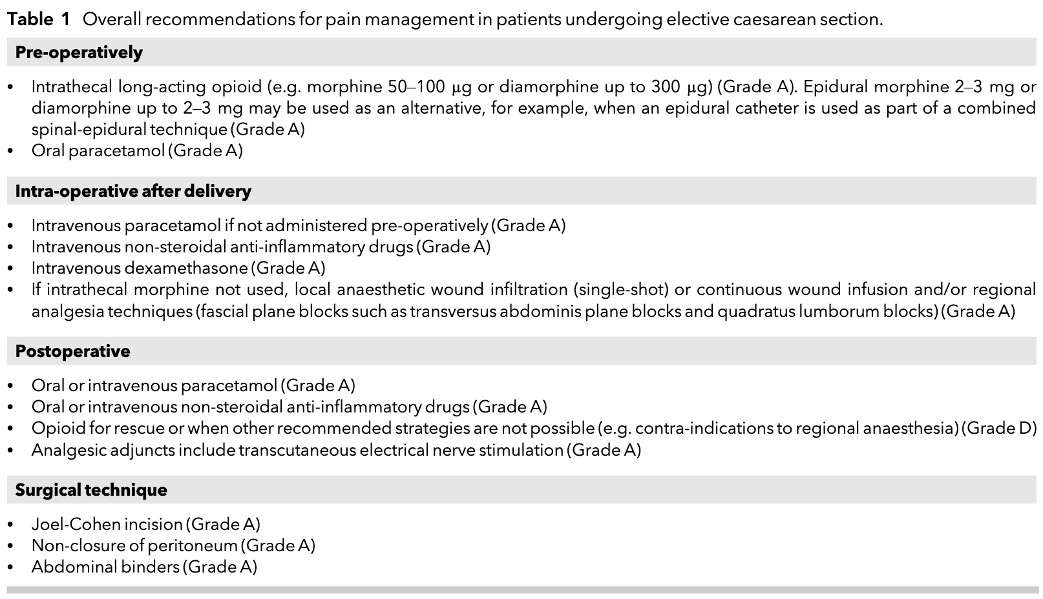

Slide 69
Audit Proposal
A retrospective clinical audit comparing the pain management of patients undergoing caesarean sections against the PROSPECT recommendations
Cohort: 100-150 patients who underwent caesarean sections in 2023 at Auburn Hospital
Time Frame: patients from Jan 2023- approx Jun 2023

