Slide 1

AUBURN HOSPITAL AUDIT PRESENTATION
MAY 2025
Dr R Veraiahgari & Dr A Shvartsbart
Supervised by Dr Melissa Chin

Slide 2
INTRODUCTION
‘Sip Til Send’ is a district-wide fluid fasting protocol for patients undergoing elective and emergency surgery
Aim to understand staff compliance with ‘Sip Til Send’ guidelines at Auburn Hospital
Audit components
Retrospective data audit
Survey
Talk components
Summary of audit results & recommendations
Education

Slide 3
AUDIT

Slide 4
AUDIT METHODS
Retrospective audit of eMR
Data collected over 2-week period in February 2025 (10/2/25-23/2/25)
Fluid and solid fasting times, documentation of fasting instructions, emergency vs elective, type of surgery, use of bowel prep
Inclusion criteria
All adult and paediatric patients undergoing elective or emergency surgery requiring sedation or general anaesthesia
Exclusion criteria
Insufficient documentation
Emergency obstetric patients
Notes:
319-285 for contraindication

Slide 5
AUDIT RESULTS
319 patients over 2-week period 10th - 23rd February 2025
216 x elective and 103 x emergency cases
295 x adults and 24 x paediatrics
90 x plastics
82 x endoscopy
70 x general surgery
36 x ENT
35 x obstetrics & gynaecology
6 x vascular
Notes:
289 patients missed opportunity for Sip Til Send

Slide 6
AUDIT RESULTS
Median fluid fasting time
Elective surgery = 6 hours
Emergency surgery = 6.2 hours
Maximum fluid fasting time = 28 hours !!
Median solid fasting time
Elective surgery = 15.5 hours
Emergency surgery = 13.5 hours
True contraindications (CI) to Sip Til Send = 30 patients
Reasons: acute abdomen, GLP-1 agonists, severe reflux
289 patients with missed opportunity for Sip Til Send!
* Note patients with CI’s were excluded from subsequent analysis *
Notes:
BTOWN – 4.18 el, 6.28 em

Slide 7
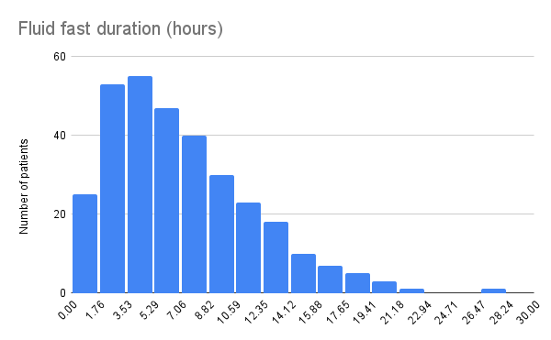
Notes:
All patients

Slide 8
Category | Median fluid fast time (hours)
Adults | 6
Paediatrics | 6.8
Plastics | 6
Endoscopy (bowel prep) | 7.3
Endoscopy (no bowel prep) | 4.9
General surgery | 6
ENT | 5.8
O&G | 4.8
Vascular | 5
Notes:
All patients

Slide 9
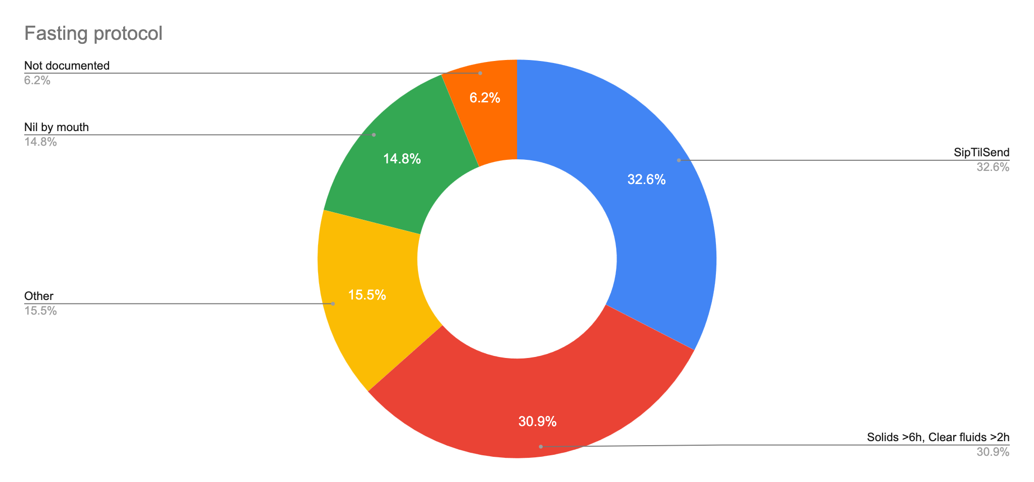
Notes:
Excludes contraindicated

Slide 10
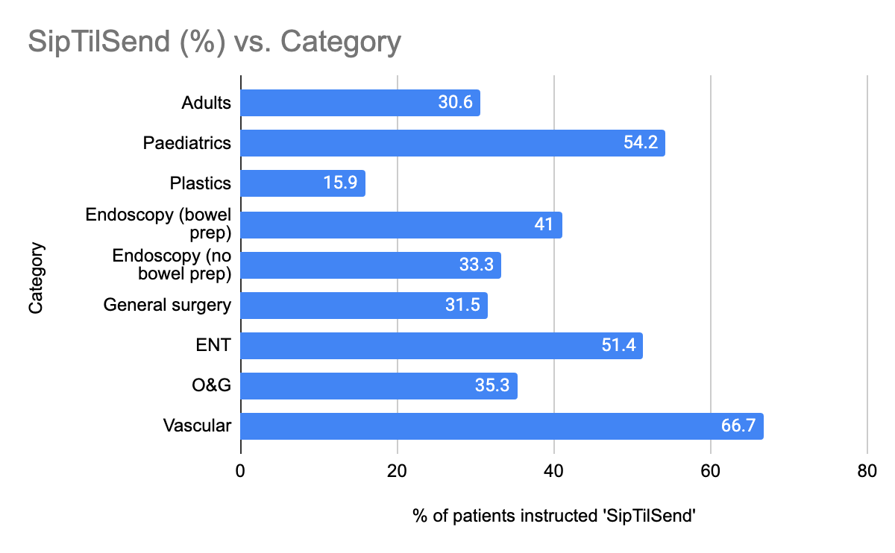

Slide 11
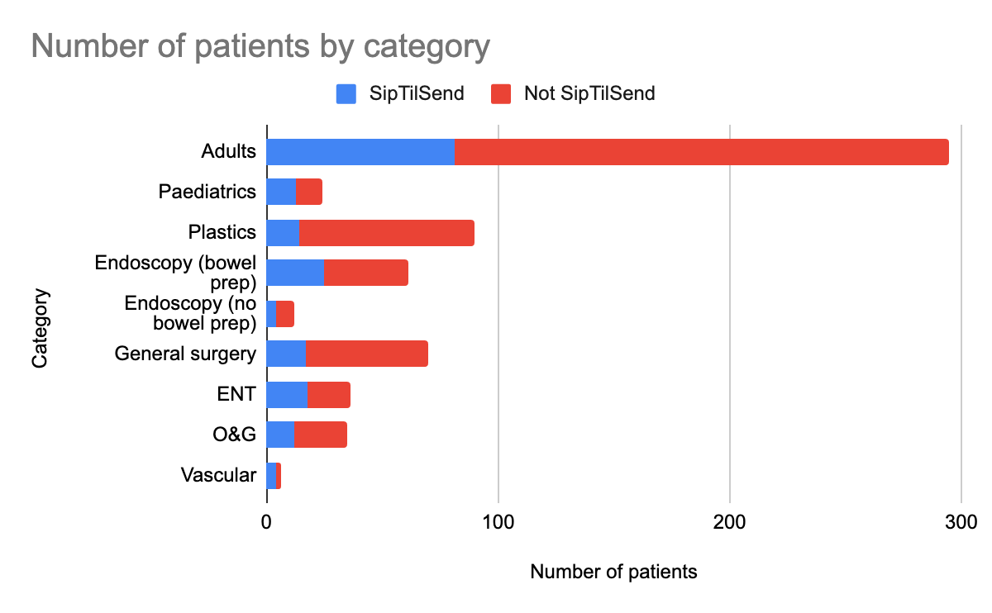
Notes:
Adjusted for sample size

Slide 12
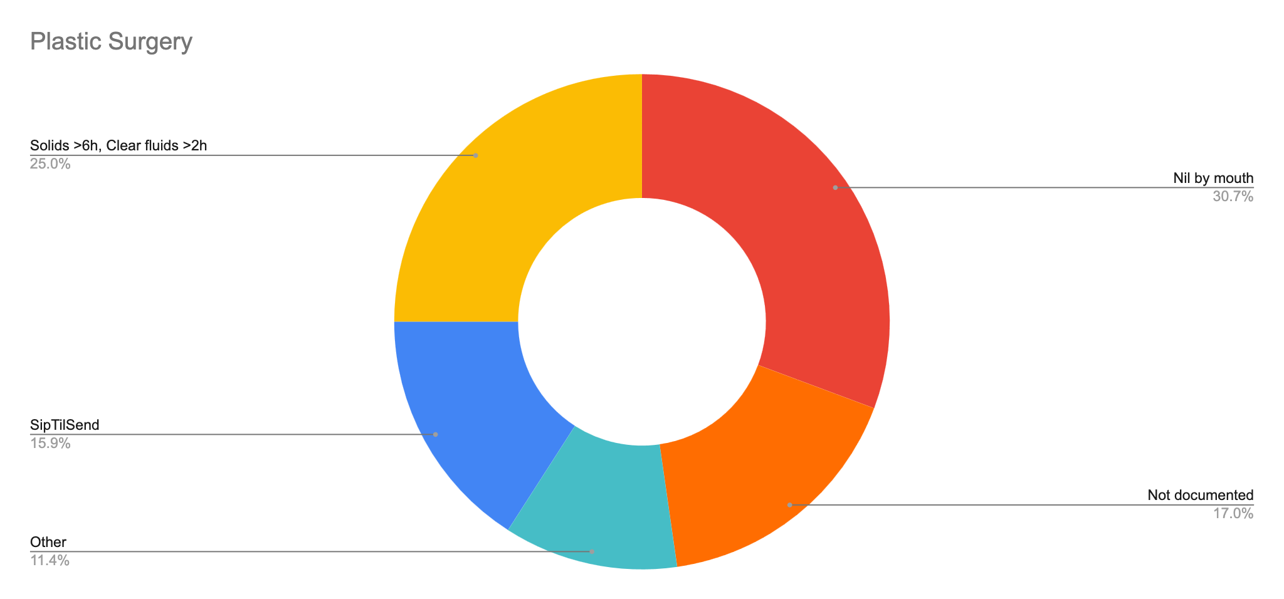
Notes:
Excludes contraindicated

Slide 13
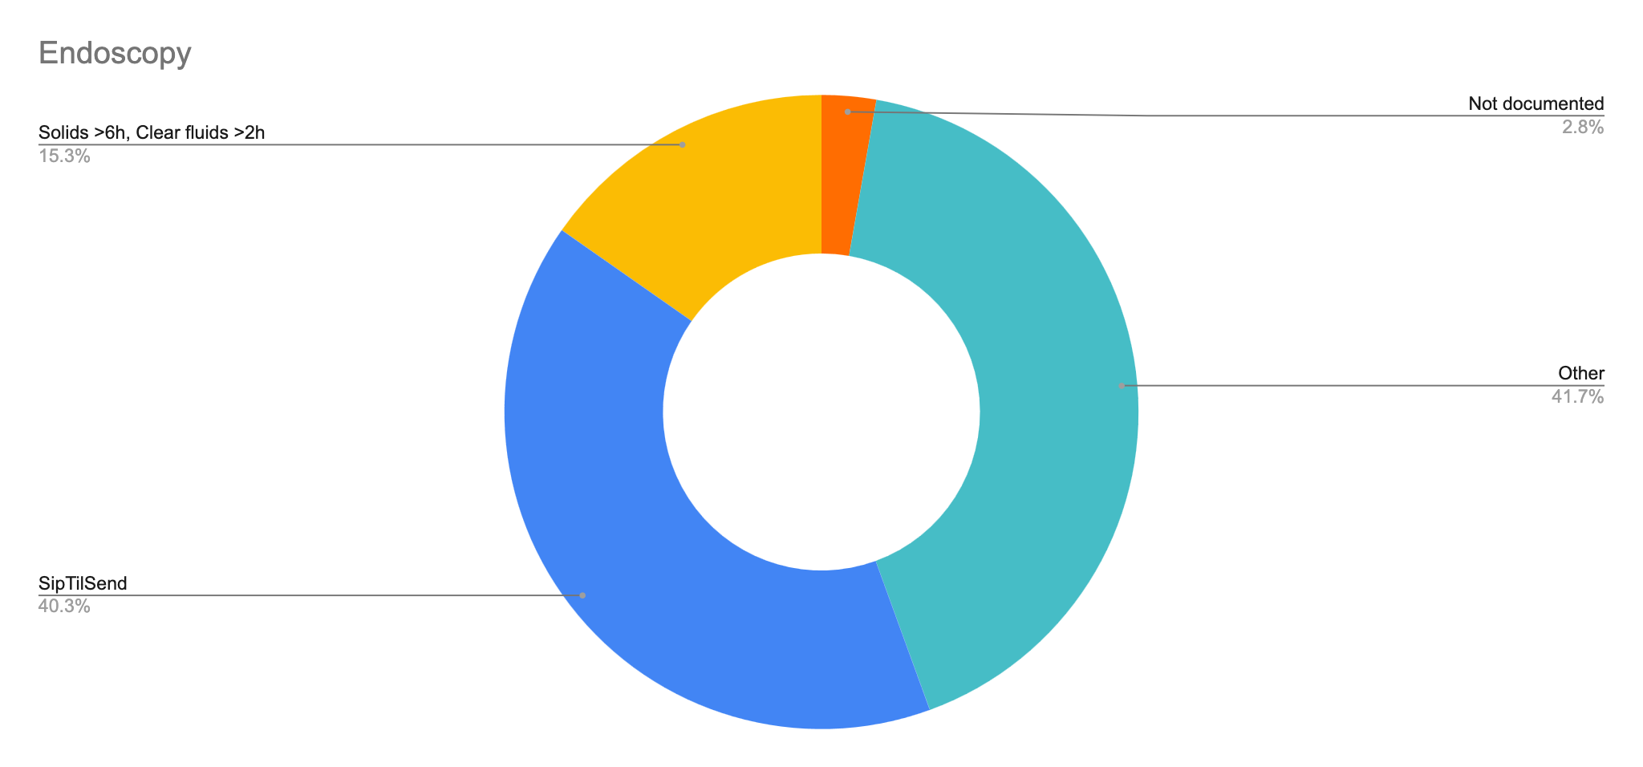
Notes:
Excludes contraindicated

Slide 14
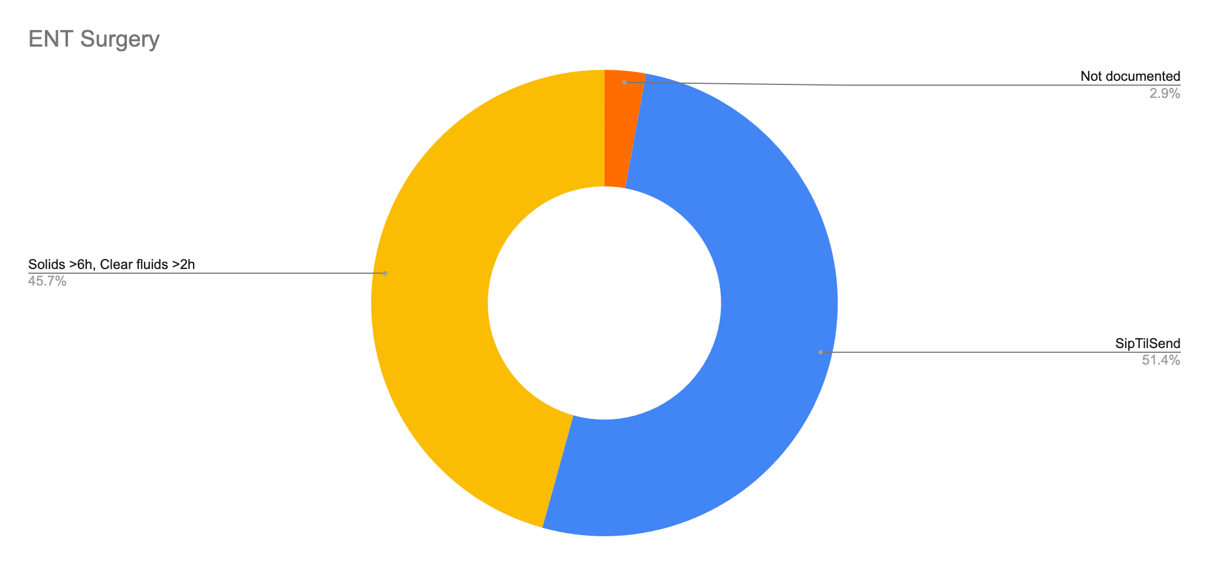
Notes:
Excludes contraindicated

Slide 15
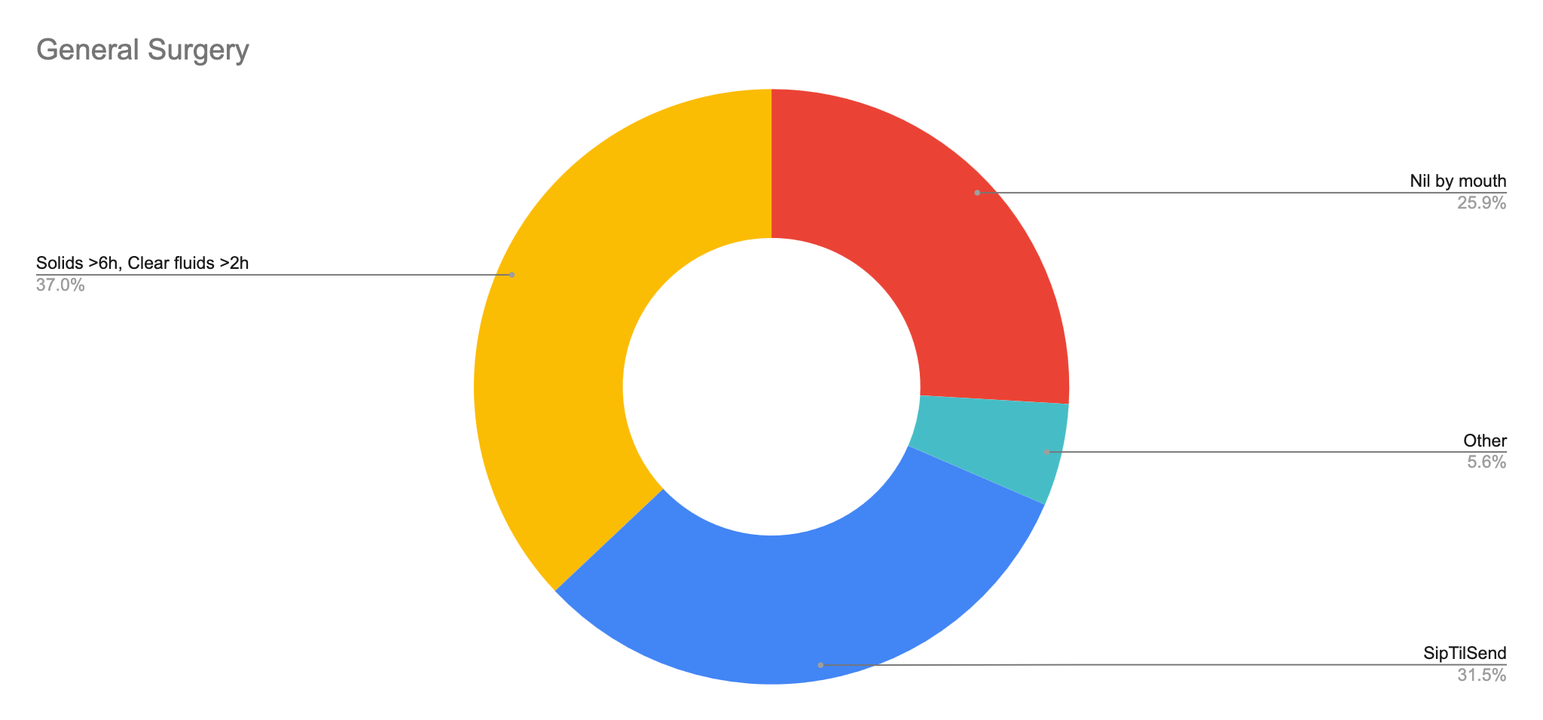
Notes:
Excludes contraindicated

Slide 16
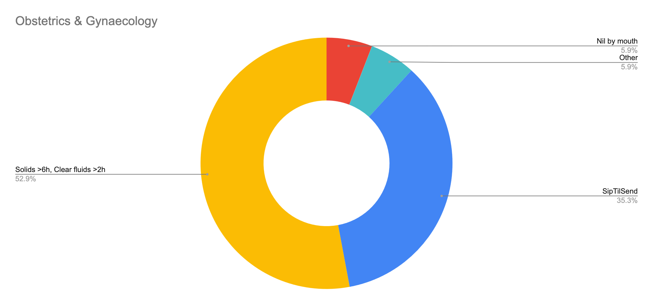
Notes:
Excludes contraindicated

Slide 17
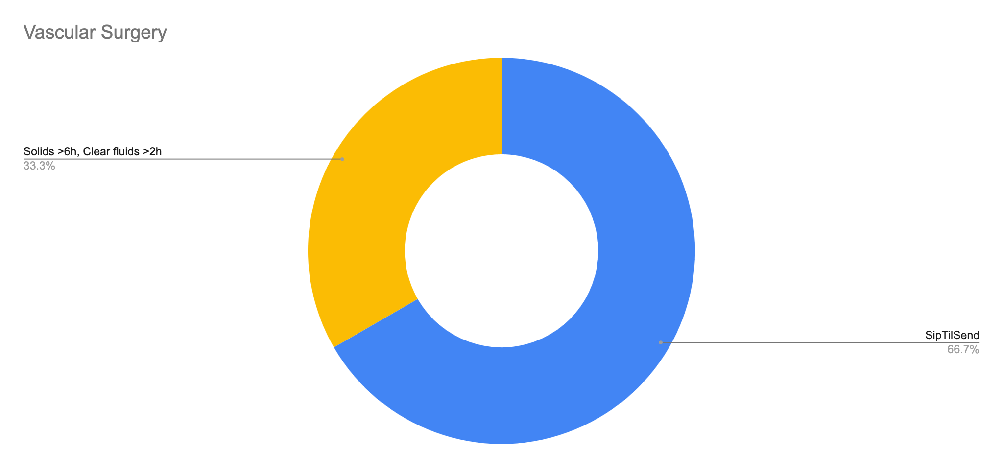
Notes:
Excludes contraindicated

Slide 18
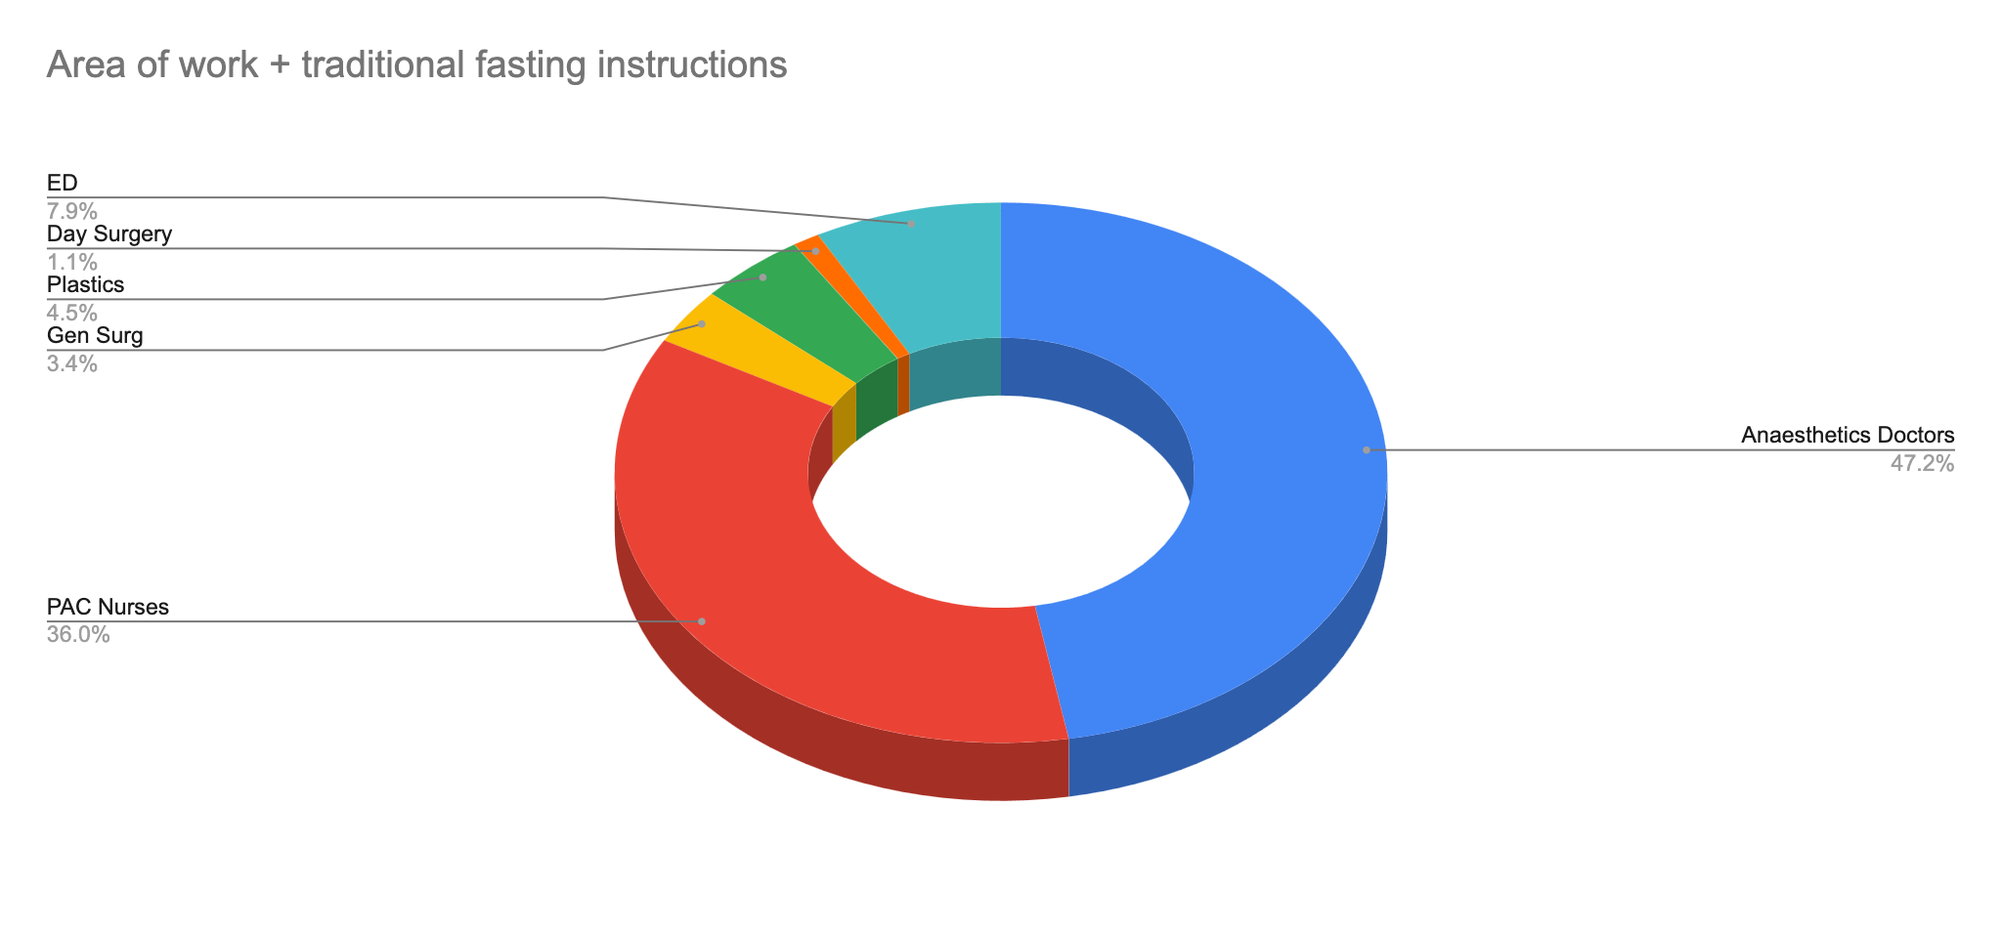
Notes:
People who document solids > 6h, liquids >2h
Excludes contraindicated
PAC is JUST nursing staff
Anaesthetics is JUST doctors

Slide 19
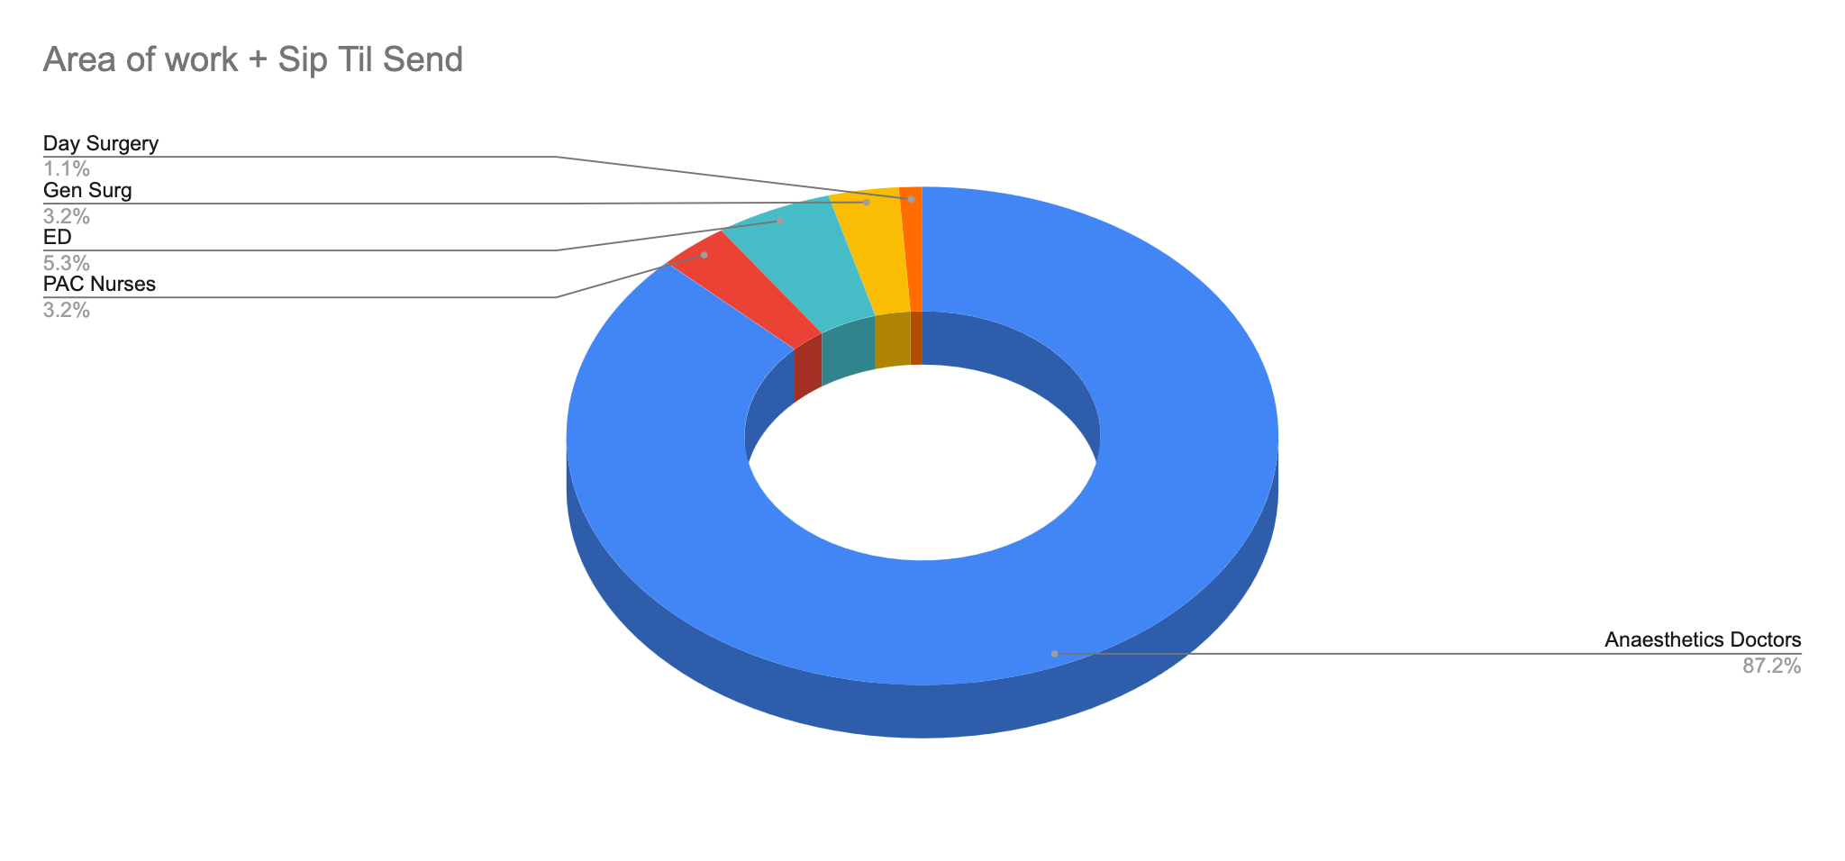
Notes:
People who document sip til send
Excludes contraindicated

Slide 20
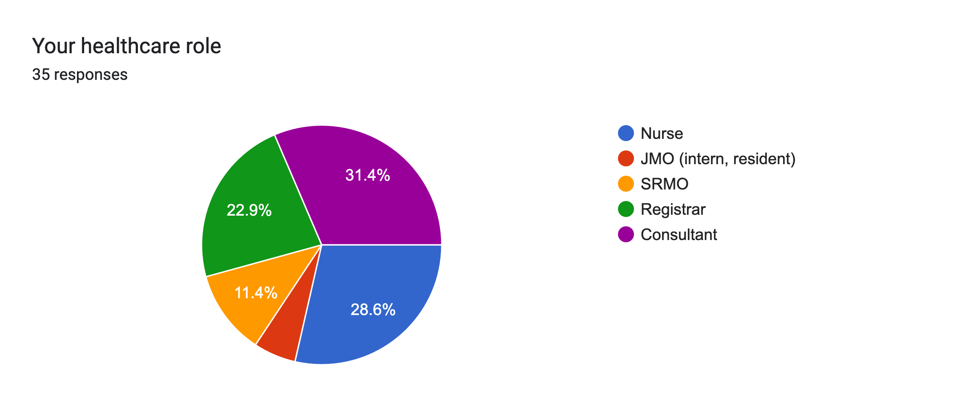
SURVEY RESULTS

Slide 21
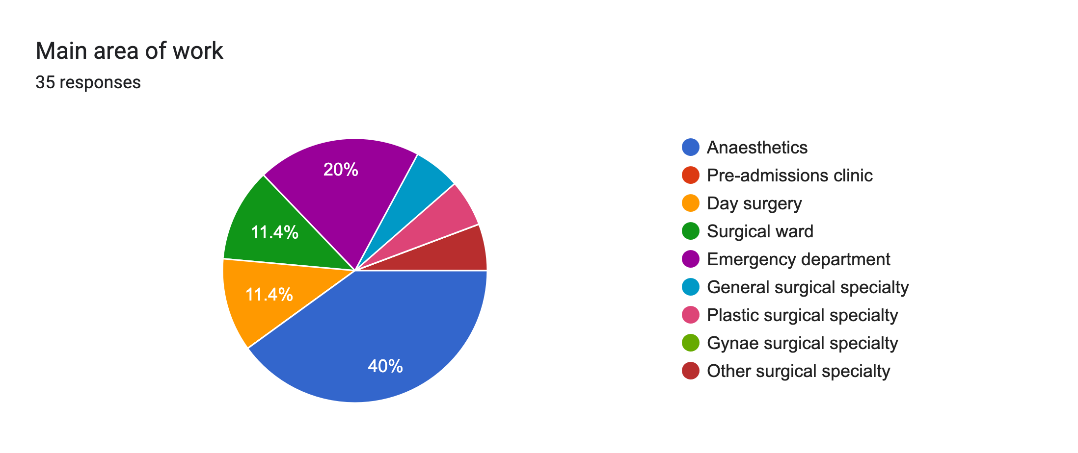
SURVEY RESULTS

Slide 22
SURVEY RESULTS How long before surgery should a patient stop solid intake?
Most answers were correct – 6 or more hours
1 answer of 2 hours

Slide 23
SURVEY RESULTS How long before surgery should a patient stop fluid intake?
Most answers were 2 hours – classic teaching
11 out of 35 answers alluded to Sip Til Send
Anaesthetists, day surgery nurses, surgical ward JMOs, surgical registrar

Slide 24
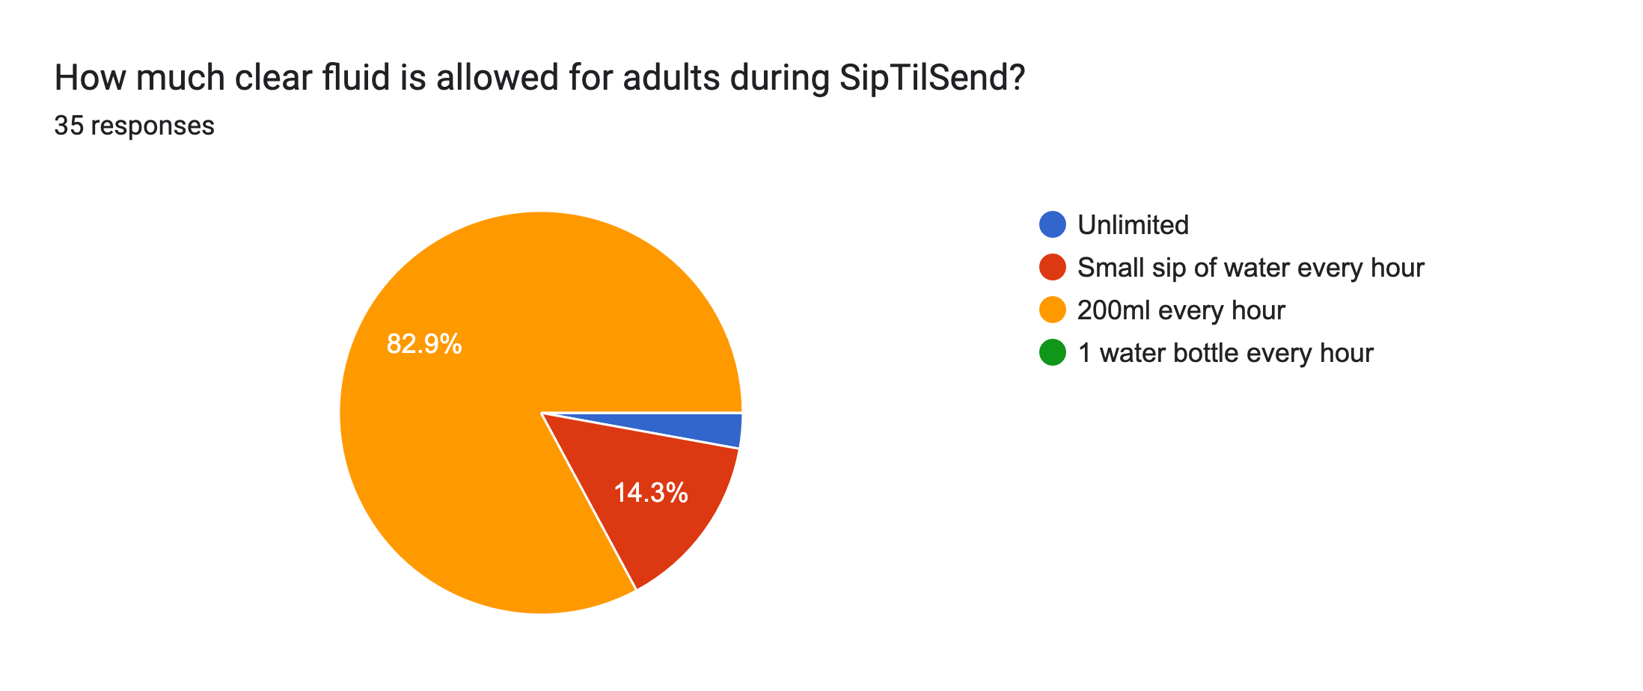
SURVEY RESULTS

Slide 25
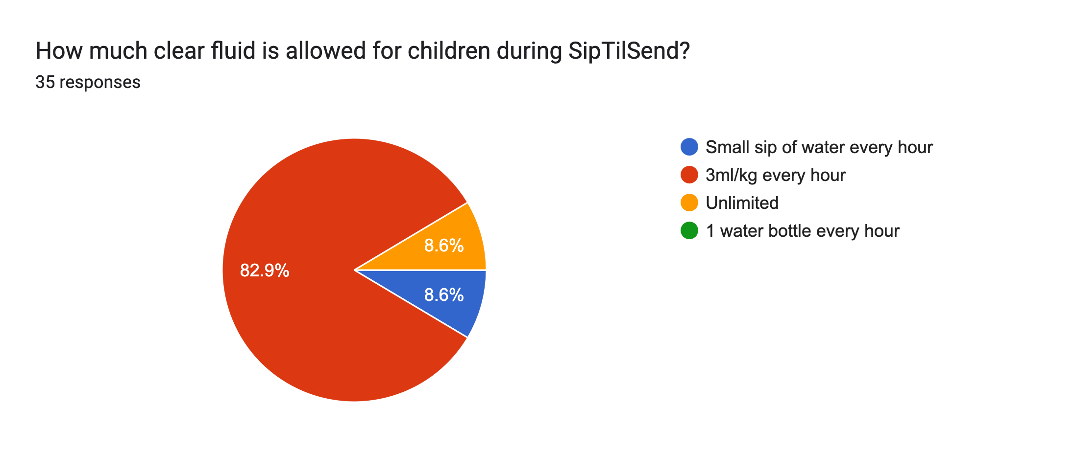
SURVEY RESULTS

Slide 26
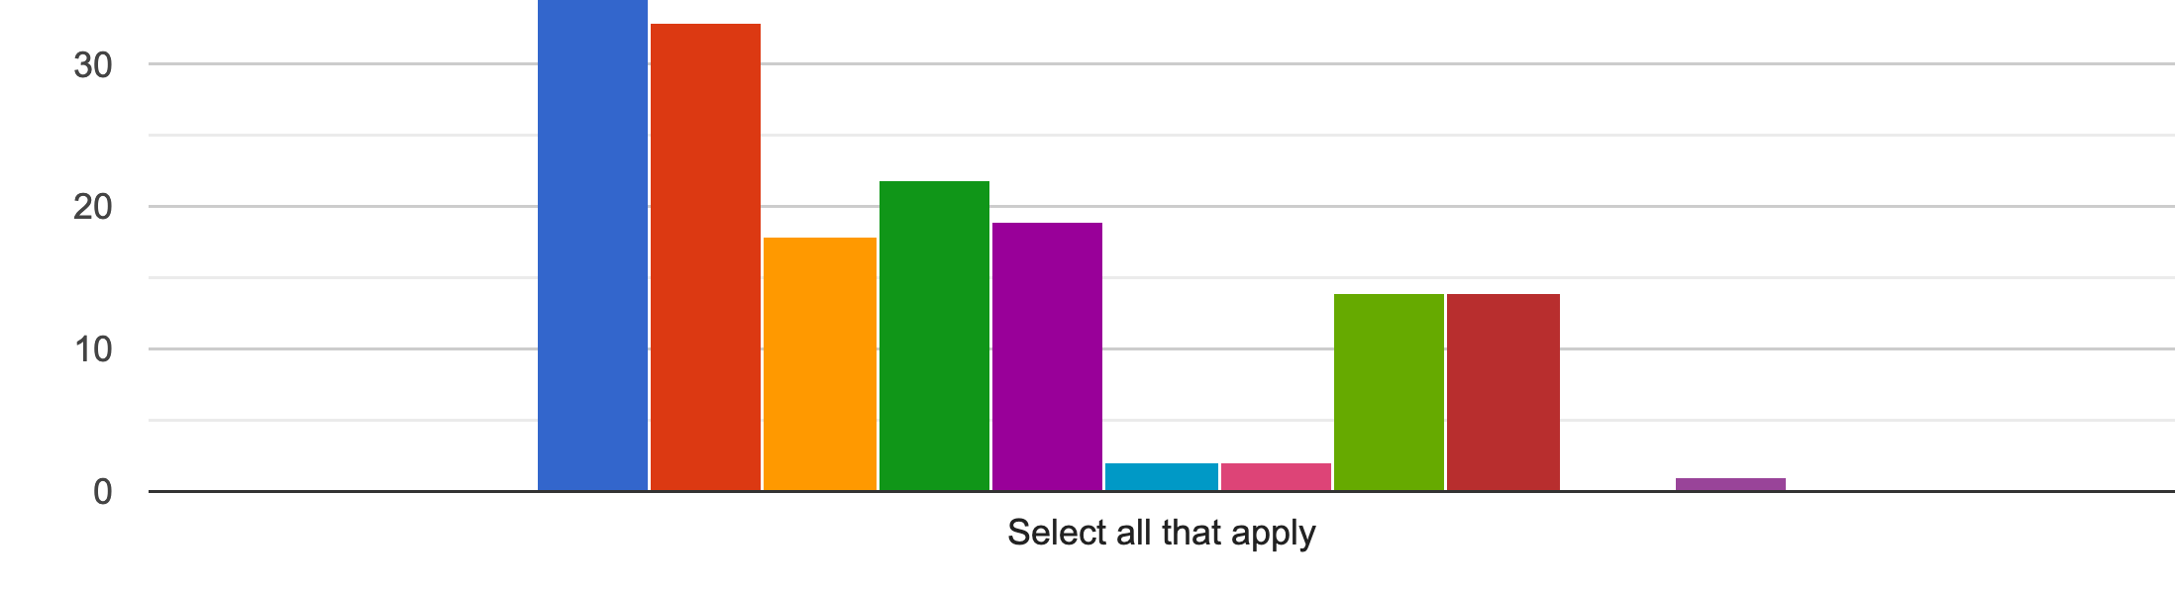
SURVEY RESULTS What types of clear fluid are allowed prior to surgery?
Water, apple juice (no bits), cordial (no jelly), ice, black coffee and black tea
Broths, soups, fizzy drink, milk, orange juice
✅
❌
Notes:
None said milk, 17 included broths, 2 included soup, 2 included fizzy drinks, 1 included orange juice

Slide 27
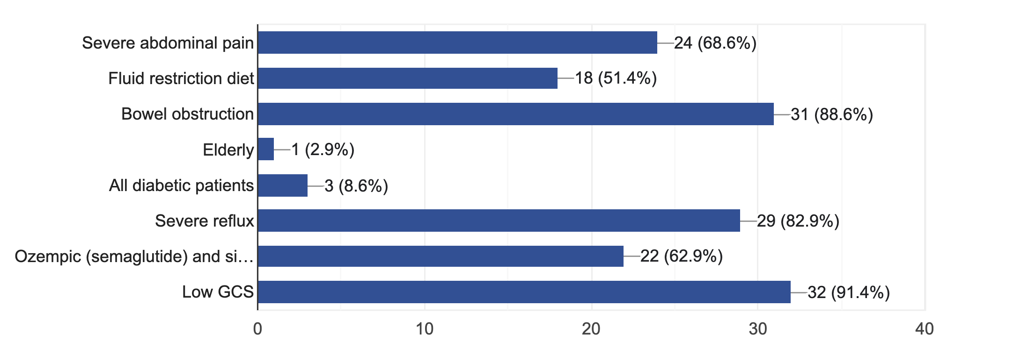
SURVEY RESULTS When should a patient NOT follow Sip Til Send?
Most answers were 2 hours – classic teaching
11 out of 35 answers alluded to Sip Til Send
Anaesthetists, day surgery nurses, surgical ward JMOs, surgical registrar
Notes:
Elderly and diabetic patients not a strict contraindication
Full list of CIs available on

Slide 28
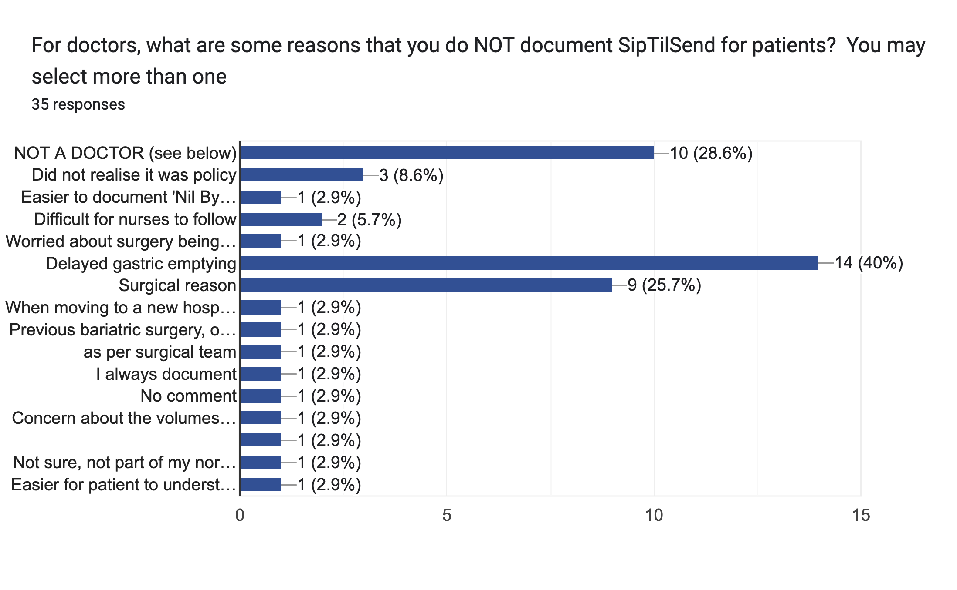
SURVEY RESULTS Reasons why doctors do not document Sip Til Send

Slide 29
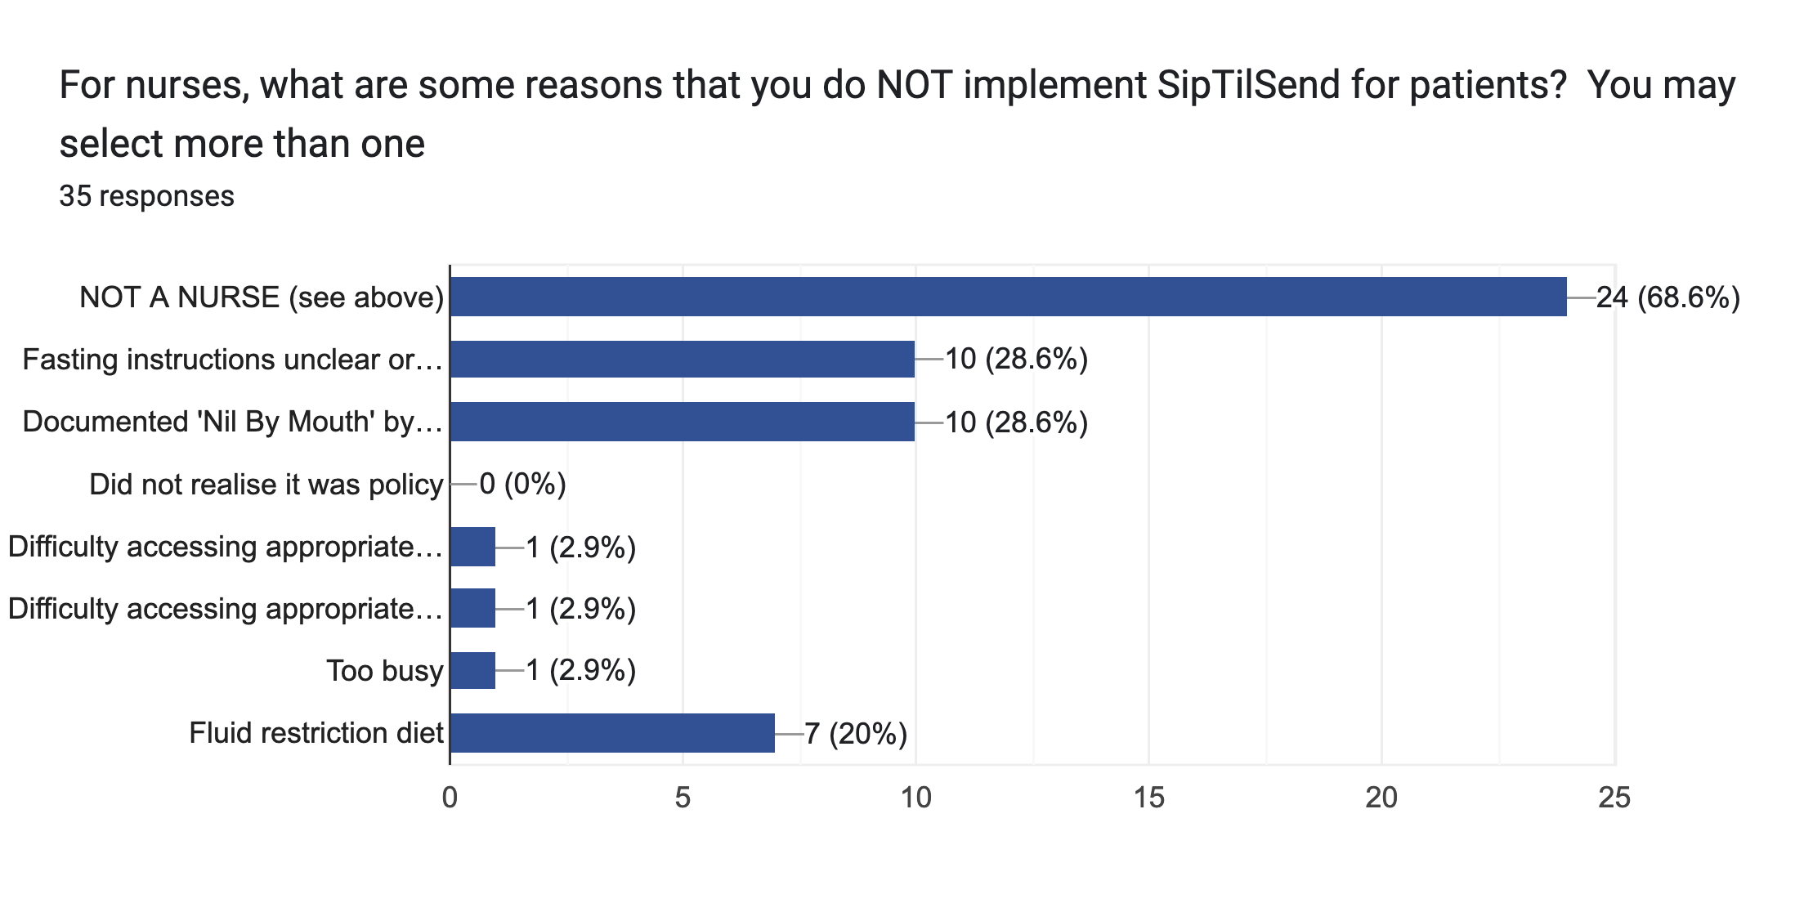
Notes:
Accessing appropriate cups and appropriate fluid types

Slide 30
SURVEY What is your single biggest barrier to applying Sip Til Send?
Institutional and cultural challenges – 8
Lack of knowledge/education around it - 6
Documentation – 5
Patient confusion/difficulty adhering to fluid limits – 4
Plastics: “Often outpatients… may overdrink fluids”; “More posters helpful”
Short-staffed/difficult to monitor – 3
Aspiration – 1
No barrier - 7

Slide 31
BARRIERS We hear you
It is very difficult to change traditional teaching on many levels
Culture
Notoriously difficult but does not mean it shouldn’t or can’t be done
Staff
Constant education and re-education required due to turnover
Staffing shortages
Ease of documentation and access to fluids/cups
Patients
Also need education and re-education
Ease of understanding instructions
Language barriers
Cultural barriers

Slide 32
CONCLUSIONS
Median fluid fasting time of 6.2 hours
Much longer than traditional teaching of 2 hours
Only 32.6% of patients instructed Sip Til Send
Out of 289 patients with no contraindications for Sip Til Send
Majority of nurses and doctors understand Sip Til Send already
Knowledge deficits in types of clear fluid allowed and contraindications
Many barriers exist
Biggest barriers appear to be institutional and knowledge-related
Bowel prep patients fast the longest (7.3 hours)

Slide 33
RECOMMENDATIONS
Focus approach on staff first
Education – in-service, department meetings, ‘check-ins’
Why? How? Why not?
Documentation, documentation, documentation!
Certification process for staff working in pre-op areas
? as part of orientation
Resources
Posters, videos, props
Deeper integration of Sip Til Send on eMR
Patient Sip Til Send info cards for outpatients
Increased availability of appropriate-sized cups and fluids in pre-op areas
Regular auditing and feedback process
Notes:
E.g. option for “Not for SipTilSend because…” and increasing culture of surgical documentation as part of plan
Also ease of documentation for nursing staff re fluid intake on iView
Sip Til Send cards for outpatients → to offload nursing staff responsibility

Slide 34
Education

Slide 35
Who said “fast from midnight?”
originated in the 1950s
came from Mendelson who noted the aspiration of solid gastric contents in obstetric patients
“seemed like a good idea” and was thus instituted across the board

Slide 36
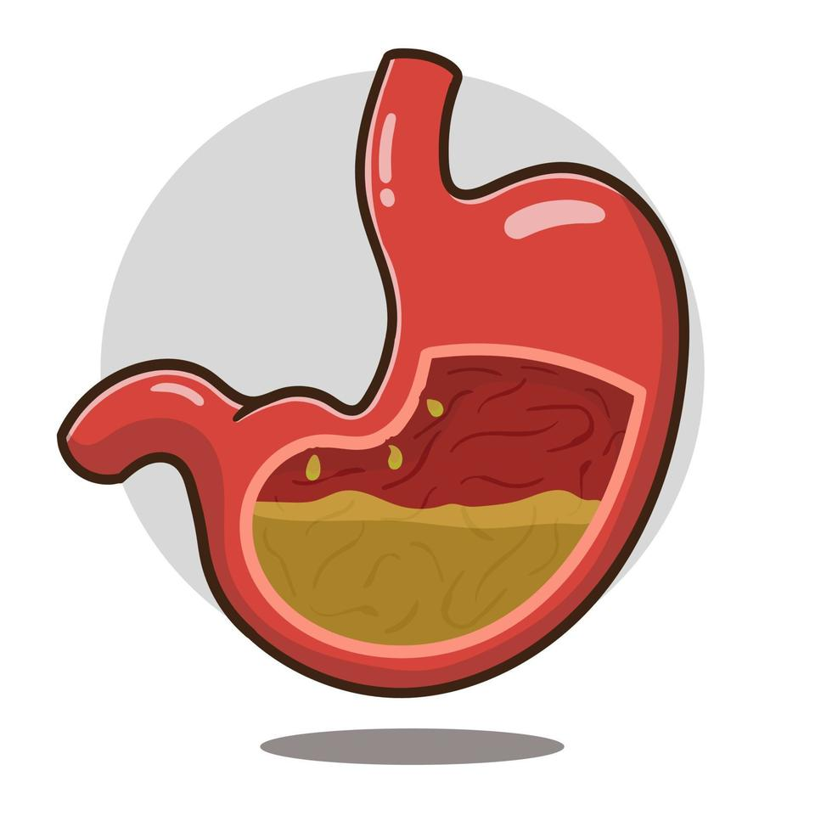
BACKGROUND Why do we fast?
The Goal: reduce the risk of aspiration of gastric contents
Aspiration: when stomach contents (liquids and/or solids) pass through the lower oesophageal sphincter and up the GIT and subsequently into the airway
need 3 things: sufficient gastric volume, increased gastric pressure, AND upper airway reflexes are suppressed/absent
Incidence of aspiration = 1 in 4000 (elective), 1 in 900 (emergency) (Warner et al.)
significant morbidity = 1 in 7200-16,500 (UpToDate)
mortality = 1 in 350,000 (NAP4)
aspiration is the commonest cause of anesthesia-related deaths (NAP4)
NB: 16 total deaths, 8 due to fatal aspiration
Notes:
incidence from a 1993 study of more than 400,000 patients
it is understood that fasting decreases gastric volume and decreased volume = decreased gastric pressure thereby lowering risk of aspiration
there is no defined gastric volume which is agreed upon that places a patient at increased or decreased risk for aspiration
important to remember there is no black and white with respect to risk of aspiration, it is a spectrum and there are those with higher risk and those with lower risk

Slide 37
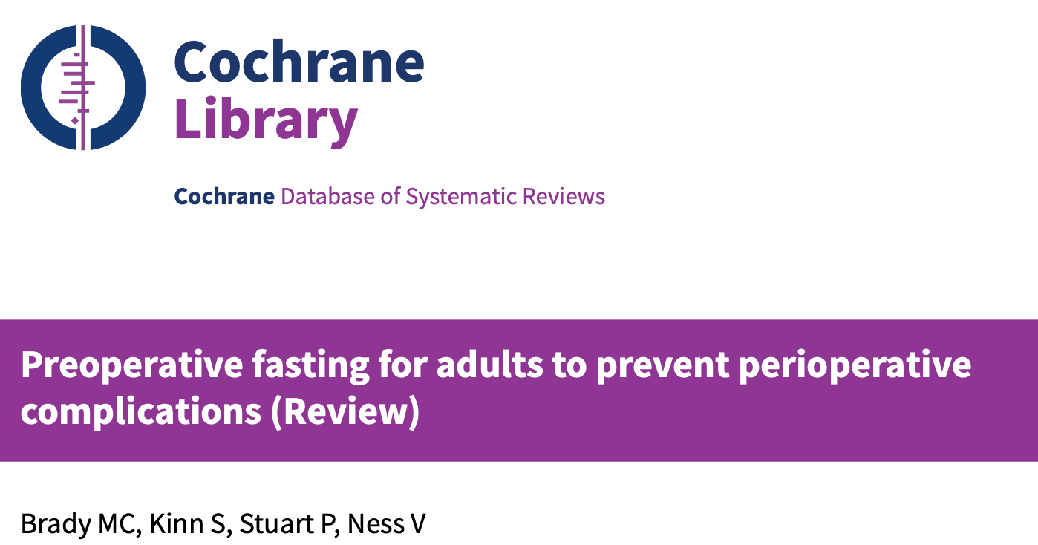
BACKGROUND What is the evidence for 2-hour fluid fast?
38 RCTs comparing post-operative complications on varying fasting instructions
mostly ASA I-II and elective patients
3 studies included obese and post-partum patients
primary outcomes: rates of aspiration, volume and/or pH of gastric contents (on induction), concentration of marker dye (Bromosulphthalein, indicates gastric emptying)
secondary outcomes: thirst, hunger, pain, anxiety, PONV
results?
NONE of the trials reported any aspiration or regurgitation across varying fasting times compared to NBM from MN populations
patient who fast overnight have the same gastric volume as those with a 2h fast
Notes:
Study done across fluid fasting times that shifted from the original “fast from midnight” - had different durations, types and volumes of fluid intake. (i.e some allowed coffee with milk or tea with honey)
adults only
120-180 min vs 90 min pre-operatively versus NBM
no difference in gastric volume, gastric pH, or gastric emptying
no increased risk of aspiration across all groups

Slide 38

BACKGROUND
Why is excessive fasting bad?
patient discomfort (hunger, thirst)
dehydration resulting in
hypotension (particularly during anaesthesia)
difficult cannulation / multiple attempts
metabolic disorders i.e ketoacidosis
electrolyte disturbance
renal impairment
post-operative insulin resistance
increased post-operative nausea + vomiting
increased patient anxiety

Slide 39
BACKGROUND What is the evidence for Sip Til Send?
how long does it take clear fluids to leave the stomach?
approximately 12 min
updated ANZCA guidelines in pre-anaesthesia consultation advocated for Sip til Send in patients without contraindications
Sip til send has shown increased patient satisfaction (Wiles & Mconald)
Swiss study of more than 22,000 patients comparing standard fluid fasting to liberal fasting times showed NO increased rates of aspiration (Schmitz et al.)
Large paediatric fluid fasting study of more than 10,000 children showed no increase in aspiration risk for <1h fluid fasting times (Beck et al.)
decreased incidence of PONV (McCracken & Montgomery)

Slide 40
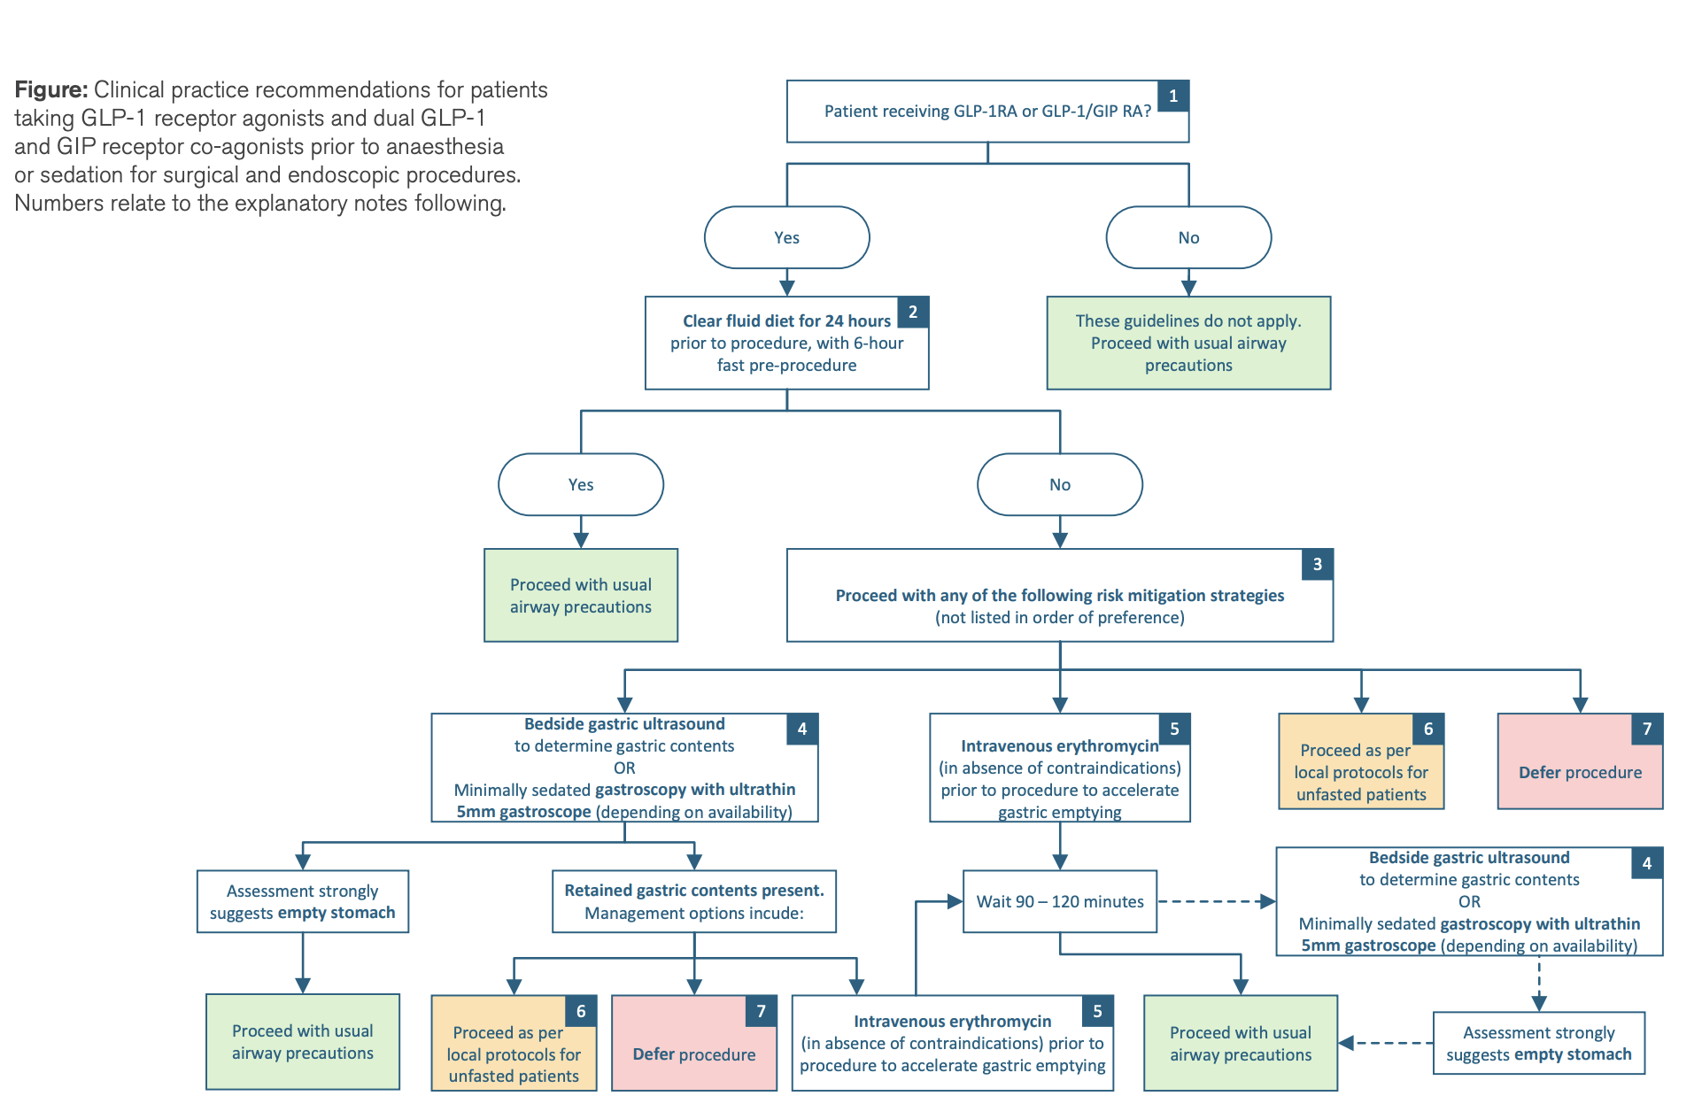
A note on GLP-1 agonists
Background: GLP-1 agonists (i.e ozempic) decrease gastric emptying and therefore increase risk for aspiration
previous recommendation was to cease the medication 2-4 weeks pre-op
New recommendations as of April 2025:
do NOT cease GLP-1 agonsits pre-operatively
clear fluid diet for 24 hours

Slide 41

WAIT SO… WHAT IS SIP TIL SEND? WHAT SHOULD I TELL MY PATIENTS?

Slide 42
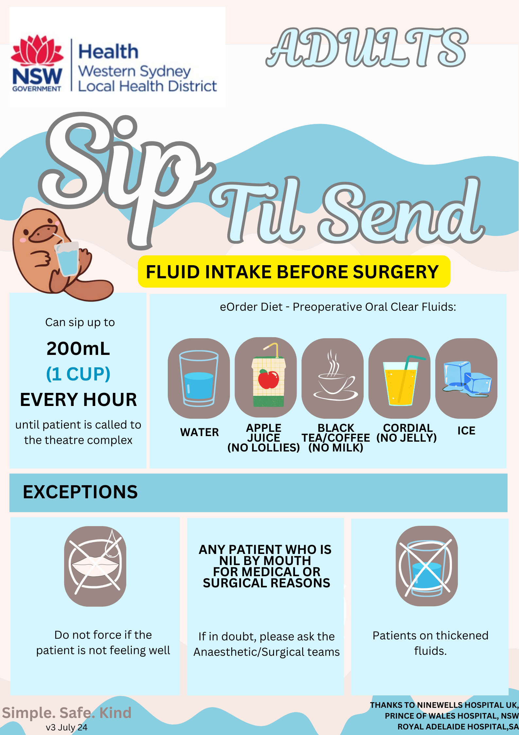
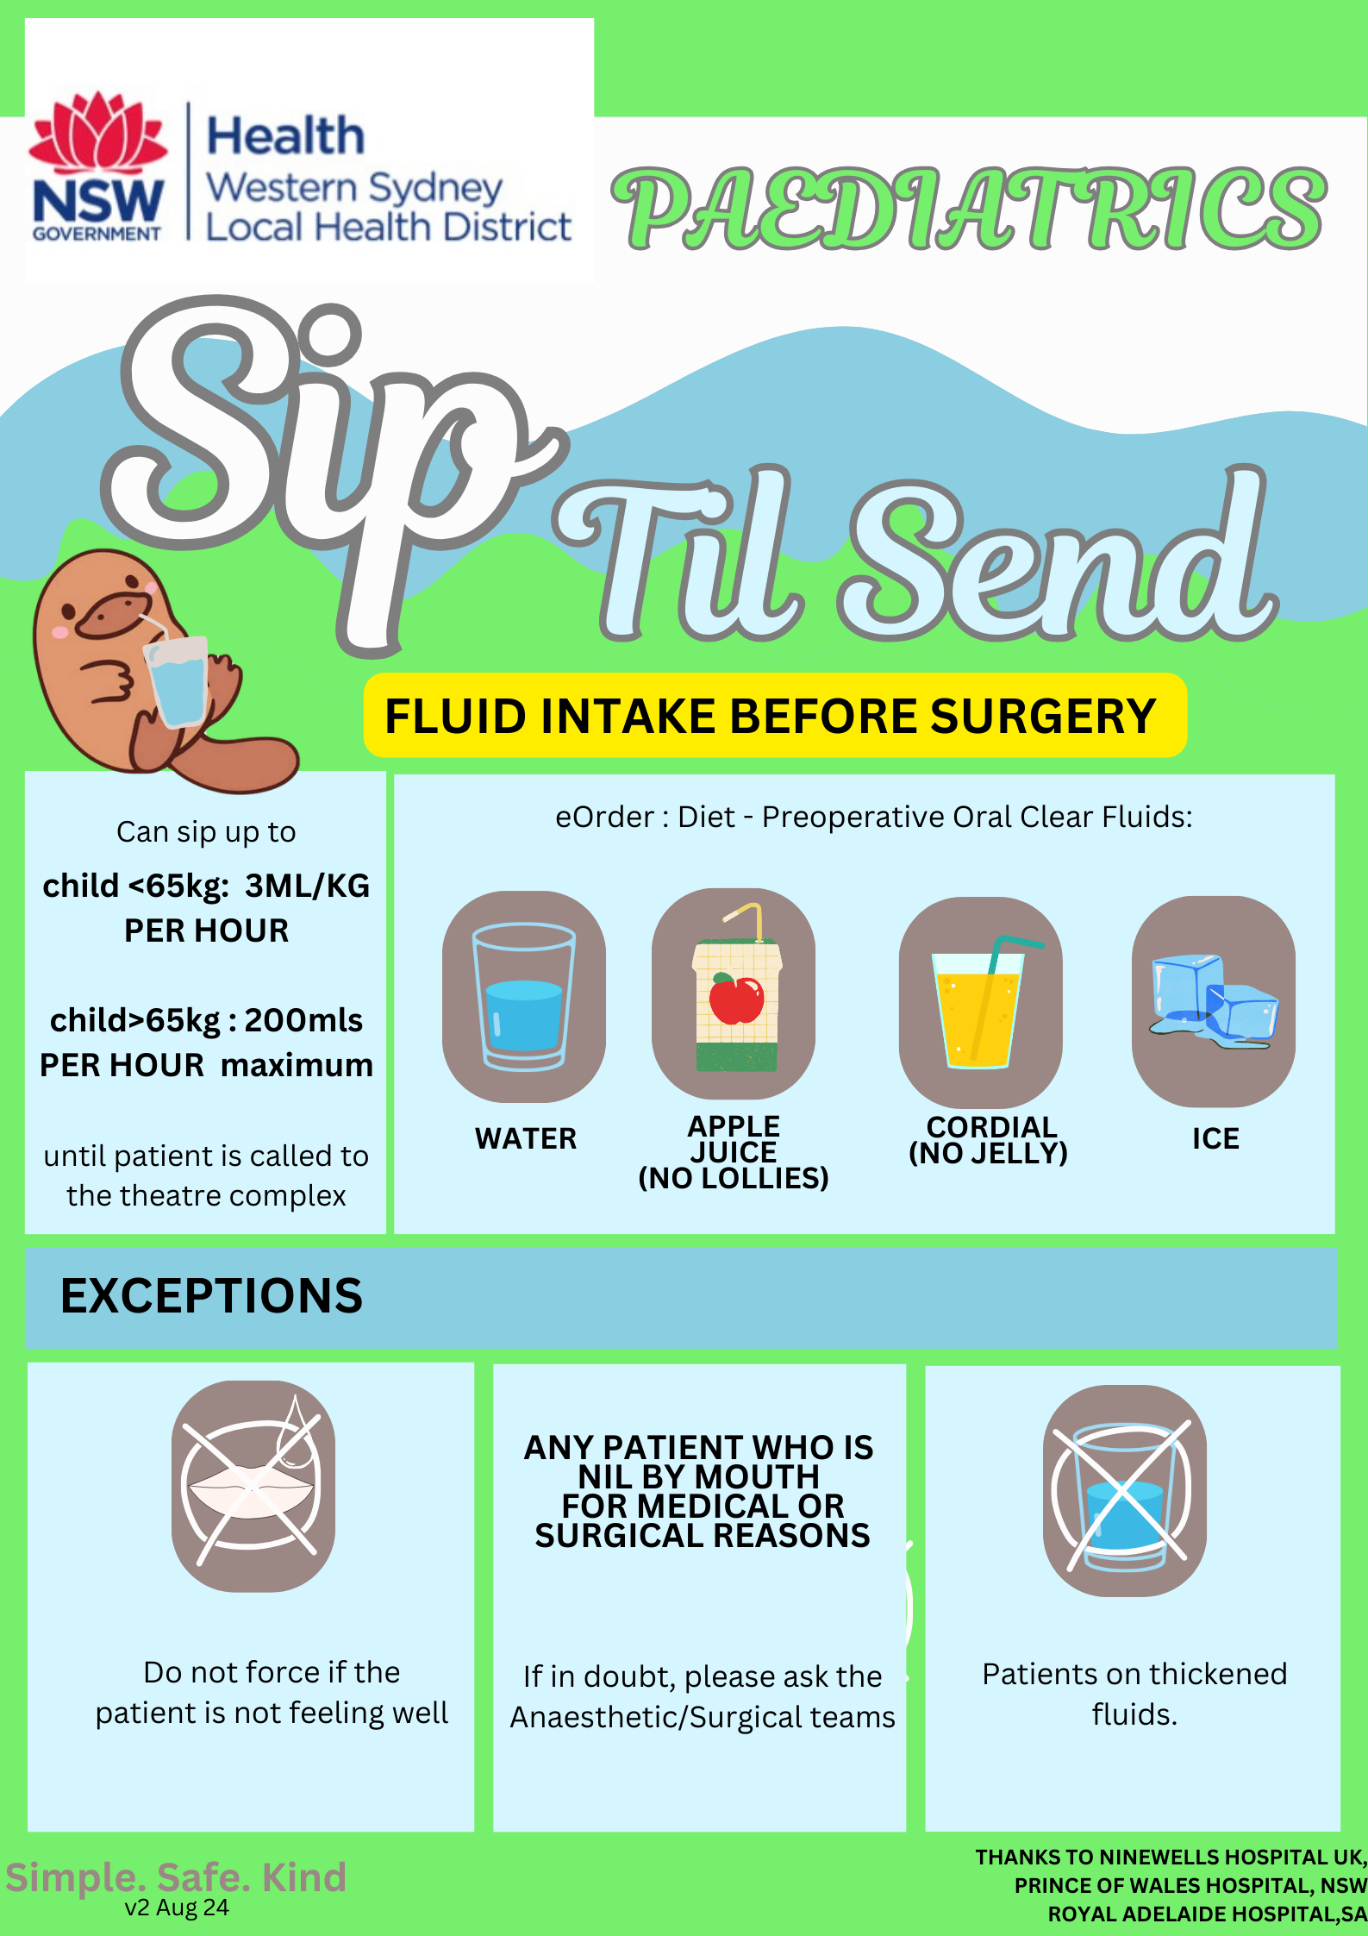

Slide 43
EDUCATION When should a patient NOT follow Sip Til Send?
Acute abdomen eg bowel obstruction/perforation
Severe abdominal pain
Acute trauma
Oesophageal stricture/foreign body/achalasia
UGI bleed
Difficulty swallowing(structural or neurological)
Low GCS state/CVA/acute intracranial pathology
Vocal cord palsy
On thickened fluid diet
Cognitive impairment
Severe hiatus hernia/regurgitation history
Severe diabetes (poor control/complications)
Sepsis/severe systemic illness
Any condition that has required large recent doses of opiates
Vomiting
Delayed gastric emptying/ gastroparesis
Specific surgical requirements
Oral contrast
Full list of contraindications accessible on: WSLHD intranet > Policies and procedures > Sip Til Send

Slide 44

Thank you for listening & HAPPY SIPPING!
Any questions?

Slide 45
References
Czarnetzki C, Elia N, Frossard JL, et al. Erythromycin for Gastric Emptying in Patients Undergoing General Anesthesia for Emergency Surgery: A Randomized Clinical Trial. JAMA Surg 2015; 150:730.
Roberts RB, Shirley MA. Reducing the risk of acid aspiration during cesarean section. Anesth Analg 1974; 53:859.
Perlas A, Davis L, Khan M, et al. Gastric sonography in the fasted surgical patient: a prospective descriptive study. Anesth Analg 2011; 113:93.
Warner MA, Warner ME, Weber JG. Clinical significance of pulmonary aspiration during the Peri-operative period. Anesthesiology 1993;78:56–62.
Brady MC, Kinn S, Stuart P, Ness V. Preoperative fasting for adults to prevent perioperative complications. Cochrane Database of Systematic Reviews 2003, Issue 4. Art. No.: CD004423. DOI: 10.1002/14651858.CD004423.
Morrison, C., Ritchie-Mclean, S., Jha, A., & Mythen, M. (2020). Two Hours too long: time to review fasting guidelines for clear fluids. British Journal of Anaesthesia, 124 (4), pp. 363-366. doi: 10.1016/j.ba.2019.11.036
Wiles MD, Macdonald A. The effect of a 'Sip til Send' policy on patient satisfaction: a quality improvement project. Anaesth Rep. 2024 Jan 6;12(1):e12271. doi: 10.1002/anr3.12271. PMID: 38187936; PMCID: PMC10771015.
Schmitz A, Kuhn F, Hofmann J, Habre W, Erb T, Preuss M, Wendel-Garcia PD, Weiss M, Schmidt AR. Incidence of adverse respiratory events after adjustment of clear fluid fasting recommendations to 1 h: a prospective, observational, multi-institutional cohort study. Br J Anaesth. 2024 Jan;132(1):66-75. doi: 10.1016/j.bja.2023.10.009. Epub 2023 Nov 11. PMID: 37953199.
Beck CE, Rudolph D, Mahn C, Etspüler A, Korf M, Lüthke M, Schindler E, Päukert S, Trapp A, Megens JHAM, Oppitz F, Badelt G, Röher K, Genähr A, Fink G, Müller-Lobeck L, Becke-Jakob K, Wermelt JZ, Boethig D, Eich C, Sümpelmann R. Impact of clear fluid fasting on pulmonary aspiration in children undergoing general anesthesia: Results of the German prospective multicenter observational (NiKs) study. Paediatr Anaesth. 2020 Aug;30(8):892-899. doi: 10.1111/pan.13948. Epub 2020 Jul 17. PMID: 32533888.
McCracken GC, Montgomery J. Postoperative nausea and vomiting after unrestricted clear fluids before day surgery: A retrospective analysis. Eur J Anaesthesiol. 2018 May;35(5):337-342. doi: 10.1097/EJA.0000000000000760. PMID: 29232253.

